Slide 1
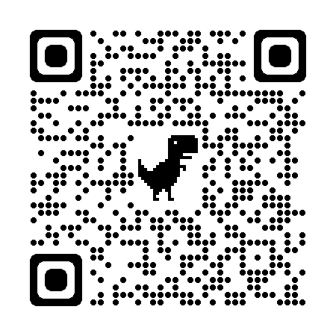
Playful Learning:
An Equity Issue
Social Change Conference
Office of Intercultural Engagement & Leadership
Texas A&M University-Commerce
February 20, 2024

Slide 2

Haley Hill
Javion Lynch
Susan Macias
Allison Odle
Carol Revelle
Allena Taylor
Josh Thompson
This session will engage participants in makerspace experiences, playing with blocks, building with Legos, using ramps and cars, and constructing with cardboard, all while listening to session leaders describe the impact of Playful Learning as Equity in schooling.

Slide 3



According to research by Dr. Stuart Brown, there are eight different types of play personalities
the joker
the kinesthete
the explorer
the competitor
the director
the collector
the artist/creator, and
the storyteller.

Slide 4

4 C’s of MakerSpace
critical thinking
collaboration
creativity
communication

Slide 5




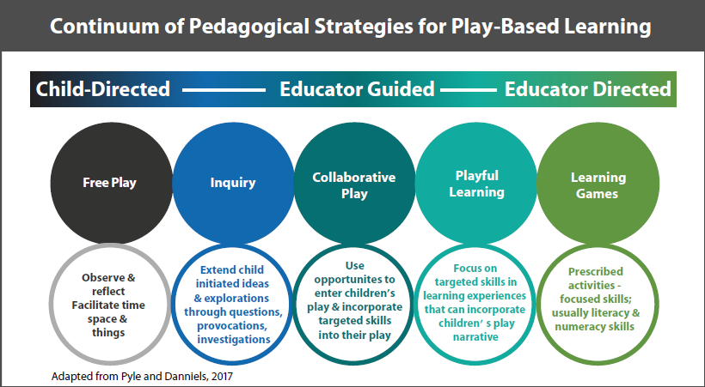


Slide 6

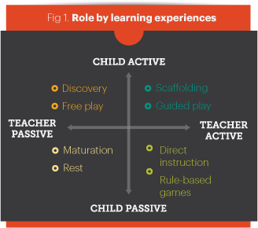

Slide 7
Researcher Mildred Parten identified six stages of play that children progress through in their first 5 years of development.
Unoccupied play Solitary play | Onlooker play Parallel play | Associative play Cooperative play

Slide 8

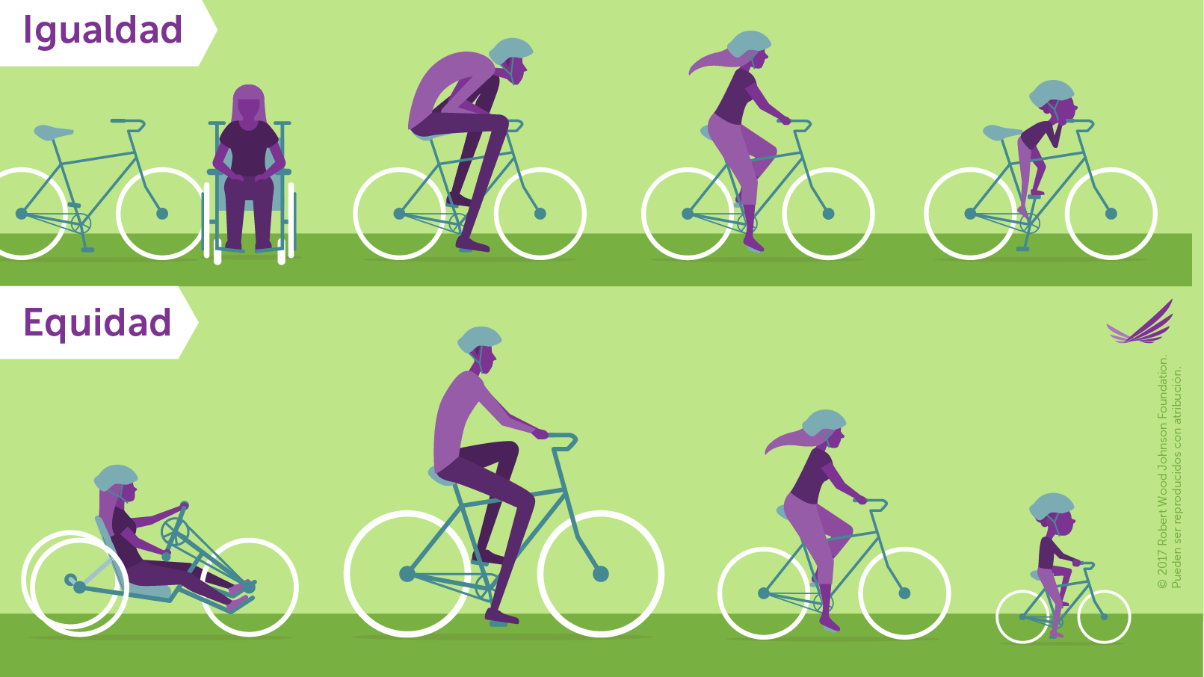


Slide 9


Slide 10
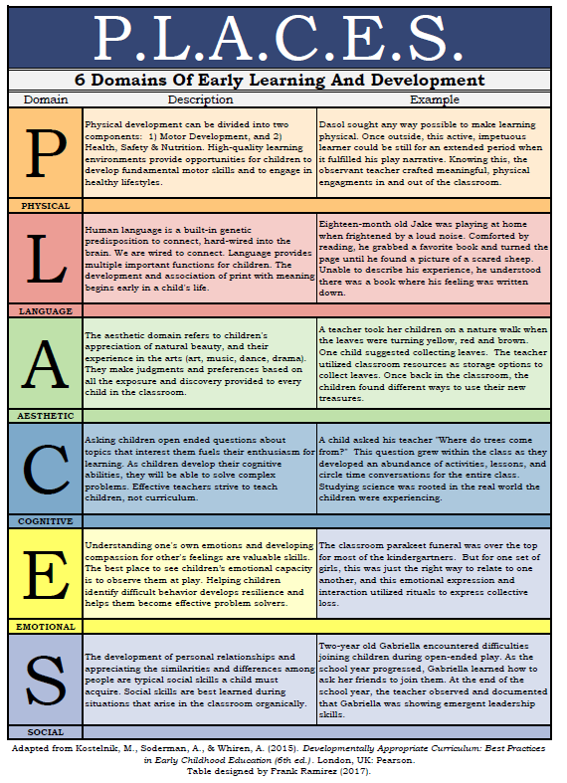

Slide 11
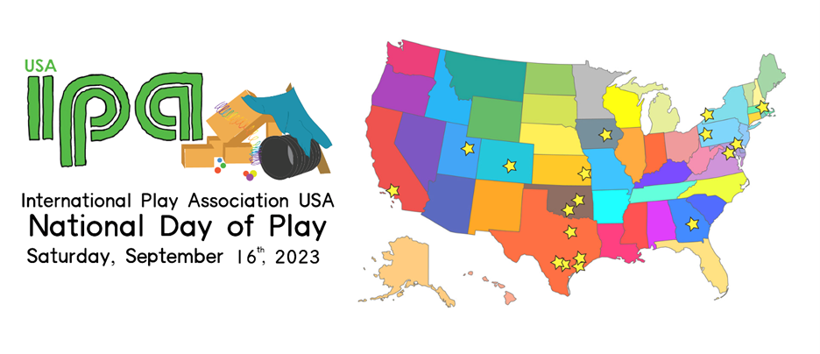

Slide 12


Slide 13





Who did you play with today?
QR Code of Exit Ticket Survey

Slide 14
What is happening at today’s Play Lab that helps you understand Playful Learning?
QR Code of Exit Ticket Survey

Slide 15
What is happening at today’s Play Lab that doesn’t help you understand
Playful Learning?
QR Code of Exit Ticket Survey

Slide 16
What could/should happen at Play Lab to help you better understand Playful Learning?
QR Code of Exit Ticket Survey

Slide 17


Thank You
Josh.Thompson@tamuc.edu
214-663-6102
http://faculty.tamuc.edu/jthompson/play
QR code for exit ticket survey

Slide 18
References
Jarrett, O. S. (2013). A Research-Based Case for Recess. The Value of Play. U.S. Play Coalition. www.usplaycoalition.Clemson.edu
Jarrett, O. S., Sutterby, J., DeMarie, D., & Stenhouse, V. (2015). Spotlight on Young Children: Exploring Play. NAEYC.
Stegelin, D. A., Fite, K., & Wisneski, D. B. (2015). The Critical Place of Play in Education. The Value of Play. U.S. Play Coalition. www.usplaycoalition.Clemson.edu
Zan & Geiken. (2010). Ramps & Pathways: Developmentally Appropriate, Intellectually Rigorous, and Fun Physical Science. Young Children 65(1) 12-17. http://faculty.tamuc.edu/jthompson/Resources/Ramps_Pathways.pdf

Slide 19
Playful Learning:
An Equity Issue
Create a ramp.
Move an object 10 feet.
Then add 2 curves.
Provocations

Slide 20
Playful Learning:
An Equity Issue
Use materials to illustrate a story.
Provocations

Slide 21
Playful Learning:
An Equity Issue
Explore the use of materials to solve a problem, fix a situation.
Provocations

Slide 22
Playful Learning:
An Equity Issue
Provocations

