Slide 1

Male Teachers:
An Endangered Species
Garry Jones, Canada; Mmatsetshweu Ruby Motaung, South Africa;
Josh Thompson, United States
http://faculty.tamuc.edu/jthompson

Slide 2
Male Teachers: An Endangered Species
  The gender of early childhood teachers affects the classroom and campus culture. There can be no doubt that male teachers are in the minority. Diverse cultures encounter this disparity in different ways, but our panel recognizes some universal themes persist around the world.

Slide 3
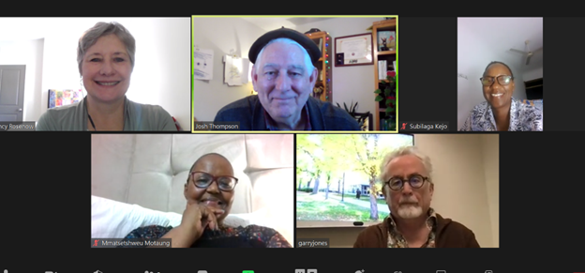
WoFo 2024 Gender Panel
Nancy Rosenow, Josh Thompson, Subi Kejo, Ruby Motaung, Garry Jones

Slide 4
Members of our panel
Mmatsetshweu Ruby Motaung, Durban, South Africa
Garry Jones, Calgary, BC, Canada
Josh Thompson, Dallas, TX, USA
==== Team Support
Kasirayi Hweta, Zimbabwe
Subilaga Kejo, Dar es Salaam, Tanzania
Nancy Rosenow, Nebraska, USA

Slide 5
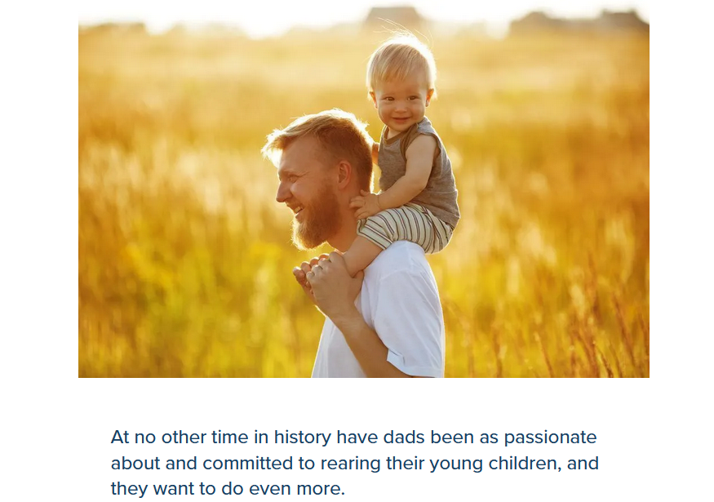

Fathers galore, Fathers glorious

Slide 6


Slide 7
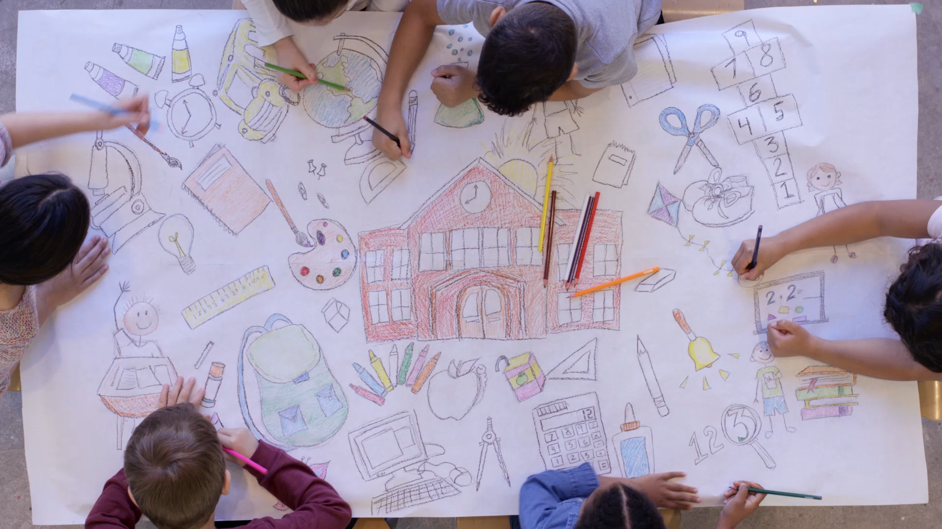
Men in Early Childhood Care and Education

Slide 8



Slide 9


Read stories about male teachers from all over the world »

Slide 10
Go to the U.S. Bureau of Labor Statistics website to see source data.
The percentage of men teachers – 2023
 | Total Employed | Men | African American (men & women) | Asian (men & women) | Latino (men & women)
Child Care | 1,036,000 | 6.2% | 15.8% | 3.8% | 25.9%
Teacher Assistants | 1,426,000 | 20.5% | 12.3% | 9.7% | 16.9%
Preschool & Kindergarten | 699,000 | 3.3% | 18.7% | 3.2% | 16.5%
Elementary & Middle School | 3,436,000 | 21.4% | 11.2% | 3.8% | 11.1%
Secondary School Teachers | 944,000 | 43.1% | 6.1% | 2.7% | 9.6%

Slide 11
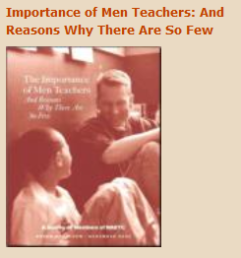

Research report – 3 big reasons for why there are so few men teachers

Slide 12
Research report – 3 big reasons why so few men are teachers
Nurturing and caring is perceived as
feminine
Compensation for caregiving is low
False perceptions of sexual motivations

Slide 13

It is time to reimagine our field and find new ways to give families the services they need. One promising way is to draw on a pool of untapped talent: our men.
– Calvin Moore, Jr., Council for Professional Recognition
Welcoming Men into Early Childhood Careers
  by David Wright
  March 6th, 2024
  www.ExchangePress.com/eed

Slide 14
How might we get more men into ECE?
• Invite them in.
• Be intentional in recruiting them.
• Place men together for support.
• Build a culture of inclusion – no gender
stereotypes.
• Have men’s backs.
• Recognise the difference a mixed-gender
team makes.
• Celebrate and promote their presence.
(Wright, 2024)

Slide 15
Male Teachers:
An Endangered Species
Garry Jones, Canada; Mmatsetshweu Ruby Motaung, South Africa;
Josh Thompson, United States

