Slide 1

Exploring the Changes of Developmentally Appropriate Practice Over Four Decades and Four Iterations in Teacher Preparation
Zlata Stanković-Ramirez, Coastal Carolina
Josh Thompson, Texas A&M University-Commerce
NAEYC PLI June 2022: Educator/Teacher Preparation

Slide 2
In this session, participants will
1.) explore changes in the four versions of developmentally appropriate practice (DAP). Presenters will
2.) share findings from a survey of preservice teachers' baseline knowledge of DAP from their published work on the topic. In conclusion, presenters will provide
3.) suggestions and recommendations for teaching the newly revised DAP to teacher educators and practitioners.
Resource page http://faculty.tamuc.edu/jthompson/dap

Slide 3
Objectives for this presentation
1. Examine the crucial components of DAP 1, 2, 3, & 4.
2. Recall DAP impact in your teaching
3. Explore Waves & Cycles of Child Development
4. Discuss questions about 3 core and 9 principles
5. Connect Crosswalk, Equity, and Unifying Framework
6. Transform your perspective and commit to help others through the process of their own transformation

Slide 4
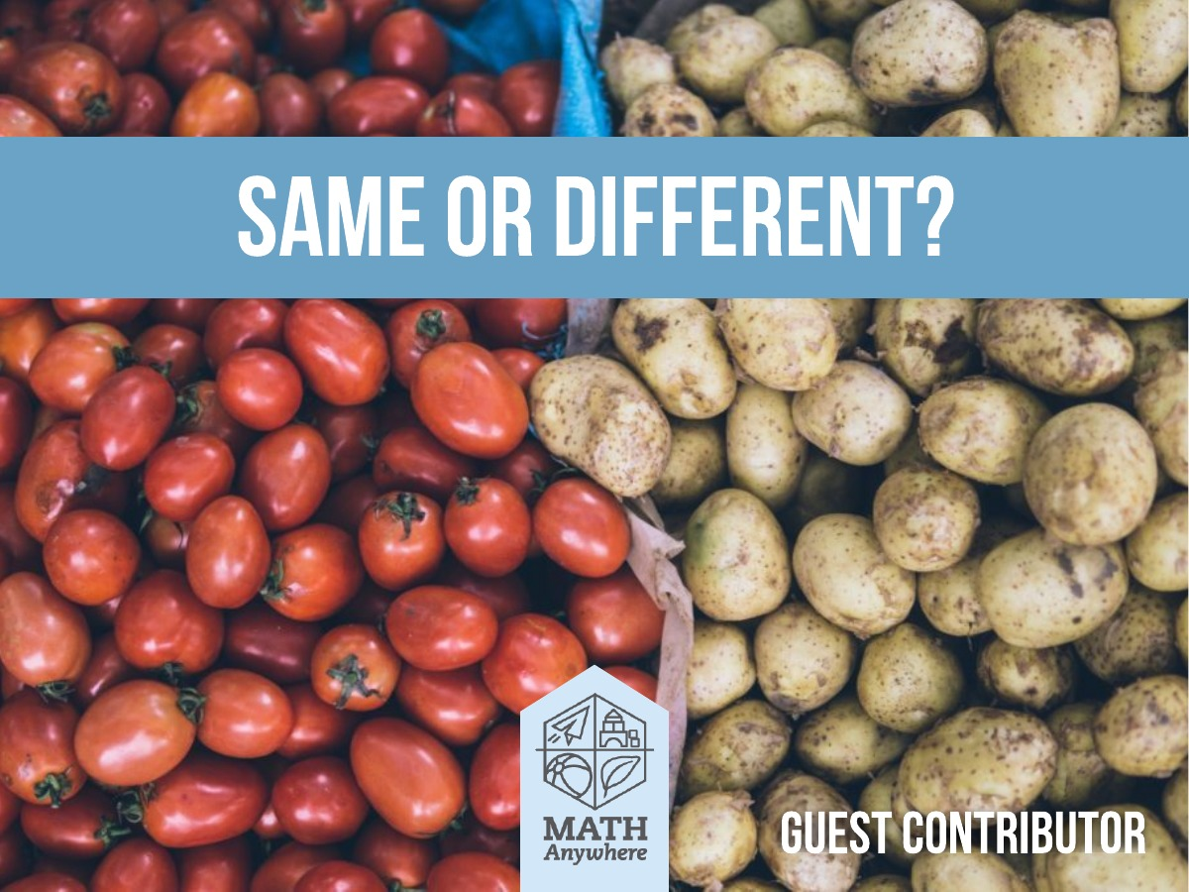
Developmentally Appropriate Practice (1987)
Primary objective: prevent “push down” curriculum from elementary to preschool level.
Two core considerations
Ages & stages, commonalities
Children’s unique developmental needs , individuality

Slide 5

Developmentally Appropriate Practice (2nd ed.) (1997)
Revised to include the third core consideration
Address diversity to include the social and cultural context for each:
  Child
  Educator
  Program as a whole

Slide 6
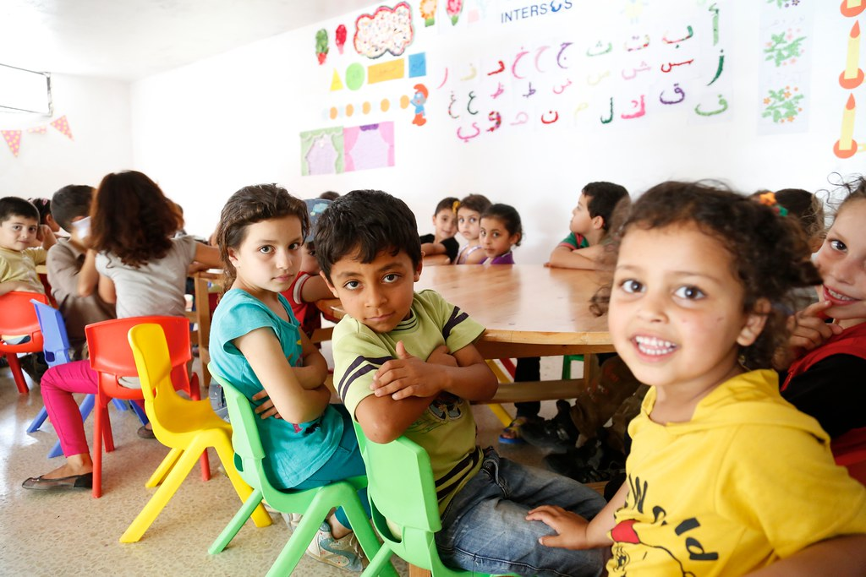
Developmentally Appropriate Practice (3rd ed.) (2009)
Identify what is “Best practice” and what is not
Typically developing children
“Best practice” promoted as a tool for assessing normative instructional practices
De-emphasized these cultural contexts and leaned in toward “best practice” for all children.

Slide 7


“It’s a mistake to try to fit children into preexisting templates, insisting that every child achieve specific milestones at specific ages.”
Thompson & Stanković-Ramirez, 2021, p. 21

Slide 8
Small group discussion
* When did you first hear about DAP?
* What were the takeaways that you applied in your classroom?
* What was missing?

Slide 9

Developmentally Appropriate Practice (4th ed.) (2020)
Major shift in emphasis, away from standards-based and towards a transformative view of the young child
Instead of Ages and Stages, Waves and Cycles
Reemphasizing the diversity and uniqueness of individual

Slide 10

“The waves of development, the ebb and flow of growth and processing, acquisition and reconsideration, all together map a process of typical child development, and attending to these waves empowers educators of children of all ages to go with the flow.”
Stankovic-Ramirez & Thompson, 2022, 5

Slide 11
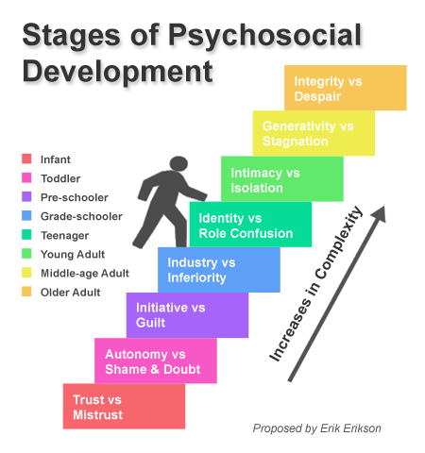
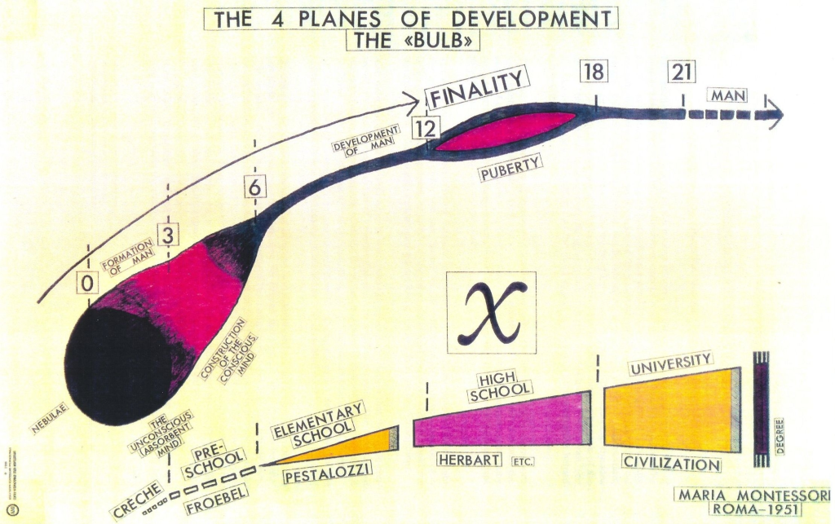
Paradigm shift
Erik Erikson
Maria Montessori

Slide 12

DAP IS CAP culturally appropriate practice
DAP is LAP linguistically appropriate practice
DAP is AAP ability appropriate practice

Slide 13
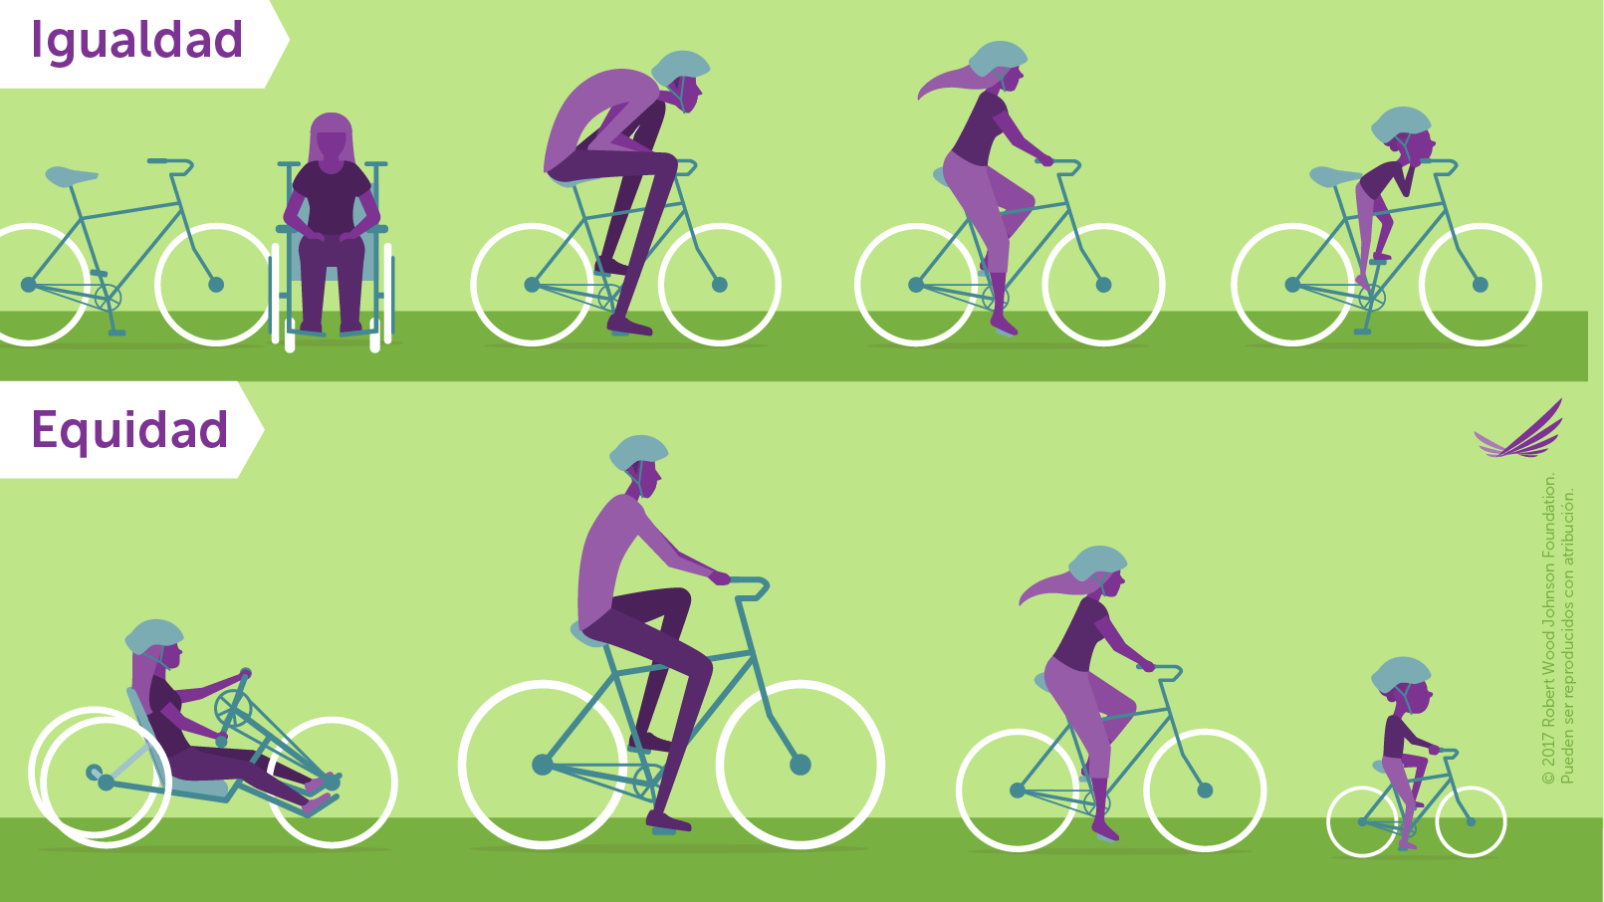
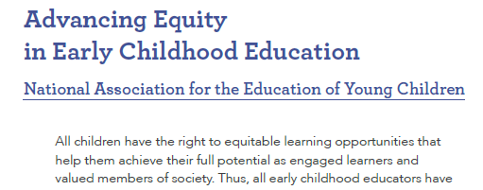
DAP is equity
NAEYC. (2019). Advancing equity in early childhood education. National Association for the Education of Young Children.
#EquityInECE

Slide 14
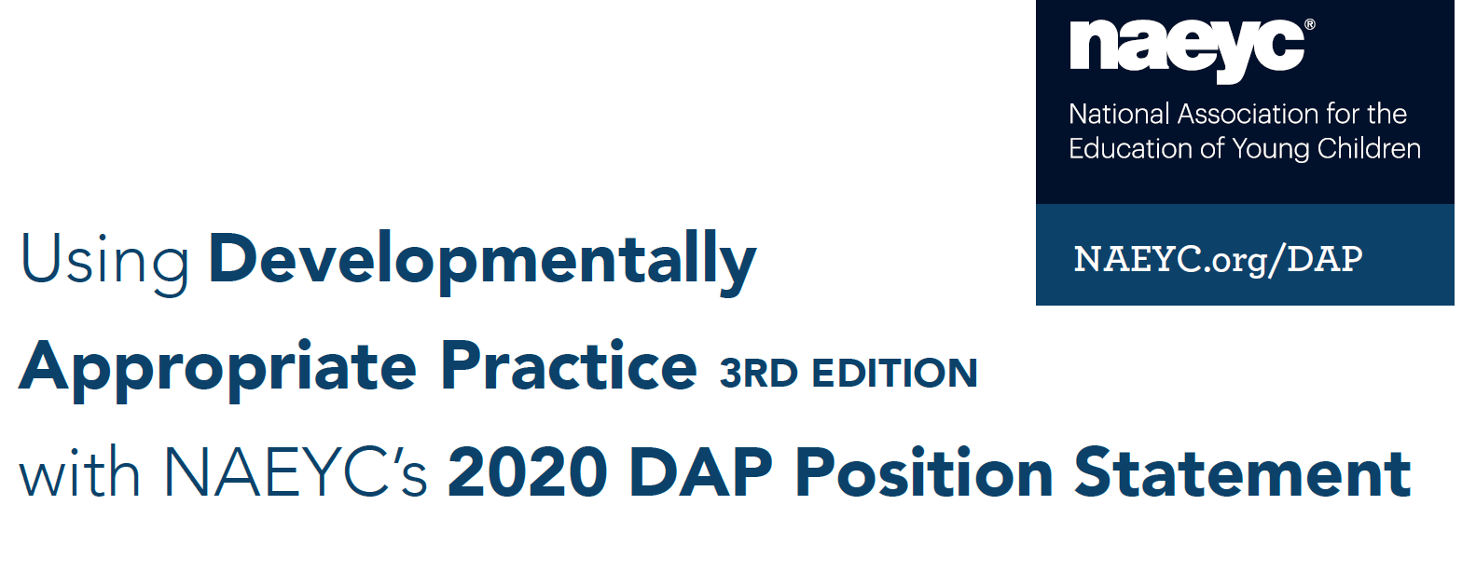

This crosswalk aligns NAEYC’s fourth edition of the DAP Position Statement with the third edition of Developmentally Appropriate Practice.

Slide 15
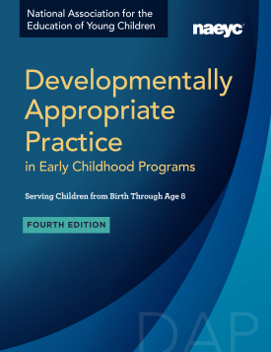
APPENDIX C:
Changes to the Position Statement, Changes to the Book: Resources and Strategies for Faculty. by Camille Catlett, Eva Horn, and Florianna J. Thompson www.naeyc.org/dap

Slide 16

DAP & UNIFYING FRAMEWORK

Slide 17
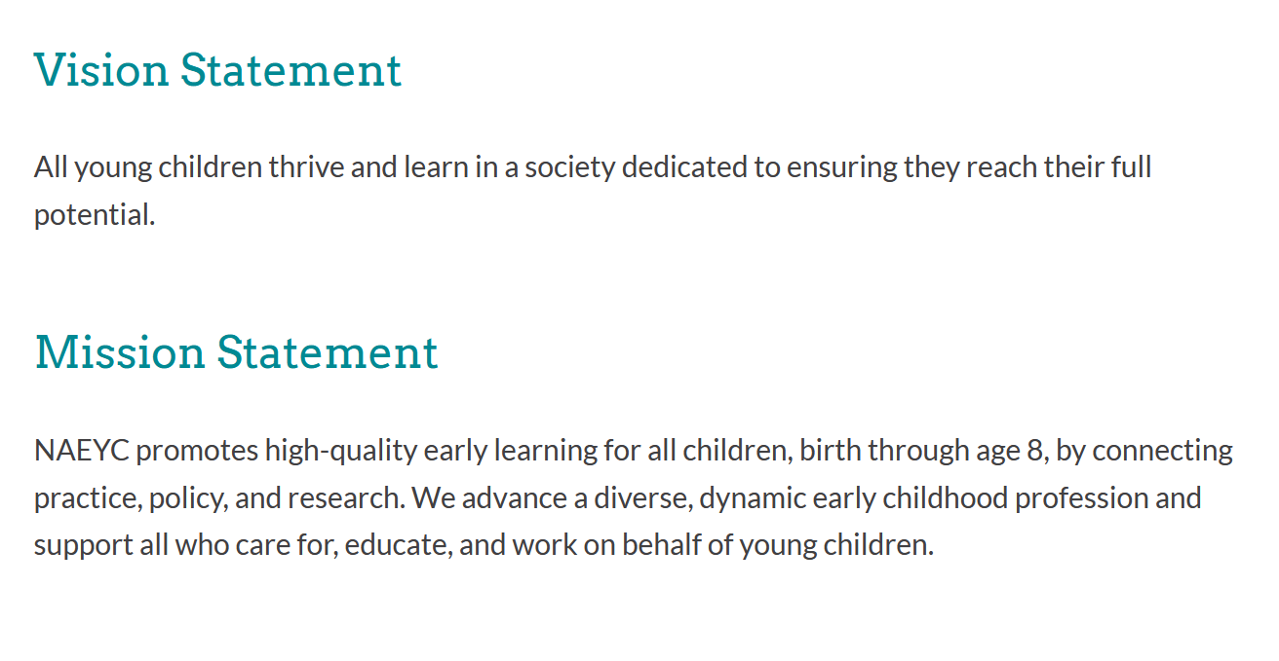
Aligning NAEYC Vision/Mission Statement with DAP

Slide 18
Small group discussion
1. Why is it important for educators at all levels to understand child development?
2. The authors describe how the newest Developmentally Appropriate Practice (DAP) guidelines uses the metaphor of waves and cycles, instead of steps, to think about child development. How might thinking of development in terms of waves instead of steps change a teacher’s approach to students?
3. Why is it important for teachers to keep the Three Core Considerations in mind? What are some of the challenges of balancing all three considerations?
4. Review the Nine Principles. Share an example of that principle in practice.
5. According to the authors, DAP requires educators to “do their best to challenge their own biased assumptions and to form a more healthy and holistic view of the children in their care.” In your experience, what are some common assumptions teachers make about children that they should reconsider. Share a story of how you’ve challenged your own assumptions.

Slide 19

What early childhood educators know about developmentally appropriate practice. Phi Delta Kappan. 2021
Two college professors looking for ways to teach new DAP to ECE teachers
NAEYC DAP Symposium, June 2021
Dr. Sue Bredekamp
Dr. Barbara Willer
Dr. Kathy Hirsh-Pasek
and others
Diverse voices (authors) in DAP
Diverse children addressed through the vignettes in DAP

Slide 20
Nine Principles
Nature/nurtue
Domains
Play = joyful learning
Culture, experience, individuality MATTERS
Children as active learners
Belonging, purpose, agency = motivation and learning
Integrated learning across disciplines
ZPD level just above
Tech and media can be valuable tools
Three Core
Commonality
Individuality
Context

Slide 21

Texas Elementary Principals and Supervisors Association (2022)

Slide 22

Small group discussion
Who needs to know what you know about DAP?
What spaces and places should the new version of DAP be explored and explained?
When are YOU going to do it?

Slide 23

QUESTIONS AND DISCUSSION

Slide 24
REFERENCES
Bredekamp, S., & Willer, B. (2021, June 9). Intentional decision making: The core considerations. [Symposium session]. NAEYC DAP Symposium. Washington, DC.
Doucet, F., & Adair, J. (2018). Introduction: A vision for transforming early childhood research and practice for young children of immigrants and their families. Occasional Paper Series, 2018 (39). https://educate.bankstreet.edu/occasional-paper-series/vol2018/iss39/2.
Hirsh-Pasek, K. (2021, June 10). Re-imagining education: Delivering high-quality education through playful learning. [Symposium session]. NAEYC DAP Symposium. Washington, DC.
Kay, A. (2017). Illustrations on the Four Planes of Development. Blog post: Notes on Montessori, Chinese Classics and Science. https://notesonnn.wordpress.com/2017/05/27/illustrations-on-the-four-planes-of-development/
Montessori, M. (1949). The absorbent mind. Holt, Rhinehart, and Winston.
NAEYC. (2019). Advancing equity in early childhood education. National Association for the Education of Young Children.
NAEYC. (2020). Developmentally appropriate practice. National Association for the Education of Young Children.
Power to the Profession. (2020). Unifying framework for the early childhood education profession. http://powertotheprofession.org/ power-to-profession-framework-03312020-web/.
Siegler, R.S. (1996). Emerging minds: The process of change in children’s thinking. Oxford University Press.
Stanković-Ramirez, Z., & Thompson, J. (2018). Rethinking developmental domains to improve classroom observations. Texas Child Care Quarterly, 42(2), 20-27. Available online https://www.childcarequarterly.com/pdf/fall18_domains.pdf.
Thompson, J. & Stanković-Ramirez, Z. (2021). What early childhood educators know about developmentally appropriate practice. Phi Delta Kappan, 103(2), pp. 20-23. https://kappanonline.org/ what-early-childhood-educators-know-about-developmentally-appropriate-practice/.

Slide 25

THANK YOU for attending our DAP session!
Dr. Zlata Stanković-Ramirez
zramirez@coastal.edu
Dr. Josh Thompson
josh.thompson@tamuc.edu
Resource page http://faculty.tamuc.edu/jthompson/dap

