Slide 1


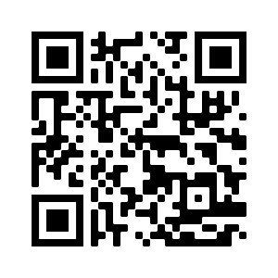
June 3, 2024
Establishing Learning Communities That Welcome Black Dads
Lindsey Wilson, PhD Josh Thompson, PhD
Notes:
Josh

Slide 2
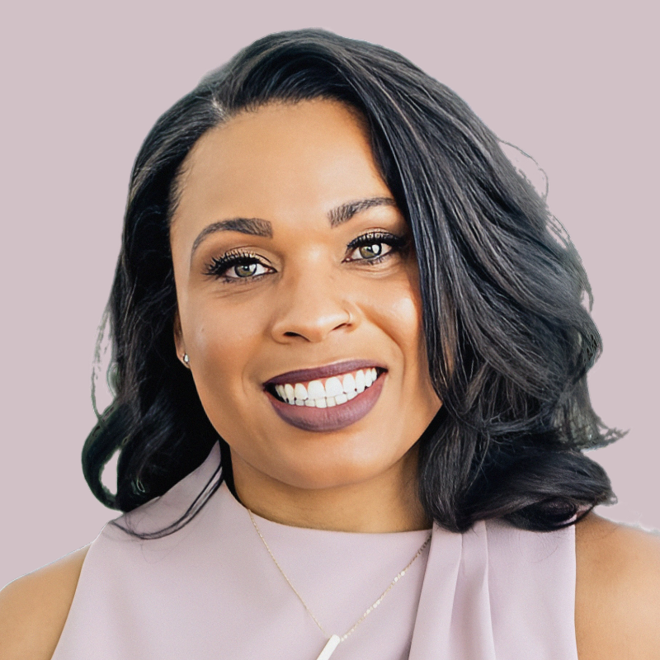
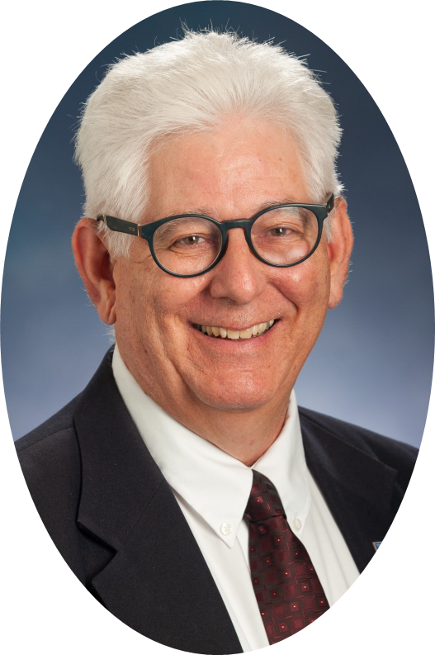
Meet the Presenters
Equity Consultant
EC Professor
He Him
ECE
Expert
Family & Community
Member
She/Her
White
European
Immigrant
on Stolen Land
Parent &
Grandparent of Multi-racial Children
Montessori
Man
African
American
Notes:
Lindsey
Josh

Slide 3

This Presentation is Based on Our Recent Published Article…
Welcoming Black Dads: Action Steps and Reflections on Becoming Culturally Competent.
Young Children
https://www.drlindseywilson.com/ http://faculty.tamuc.edu/jthompson/abar
Wilson, L. & Thompson, J. (2022). Welcoming Black Dads: Action Steps and Reflections on
Becoming Culturally Competent. Young Children, 77(4), 26-34
Notes:
Lindsey

Slide 4

First, a Story
My Daddy Did It!
(2022)
by Dr. Lindsey L. Wilson
Art by Sheila Alejandro
Valeriia Proskurina
Notes:
Josh

Slide 5

Lexie and Yazmin were talking:
“Who did your hair?”
“My Daddy does a lot.”
“Who set up all the balloons?”
“My Daddy did!”

Slide 6
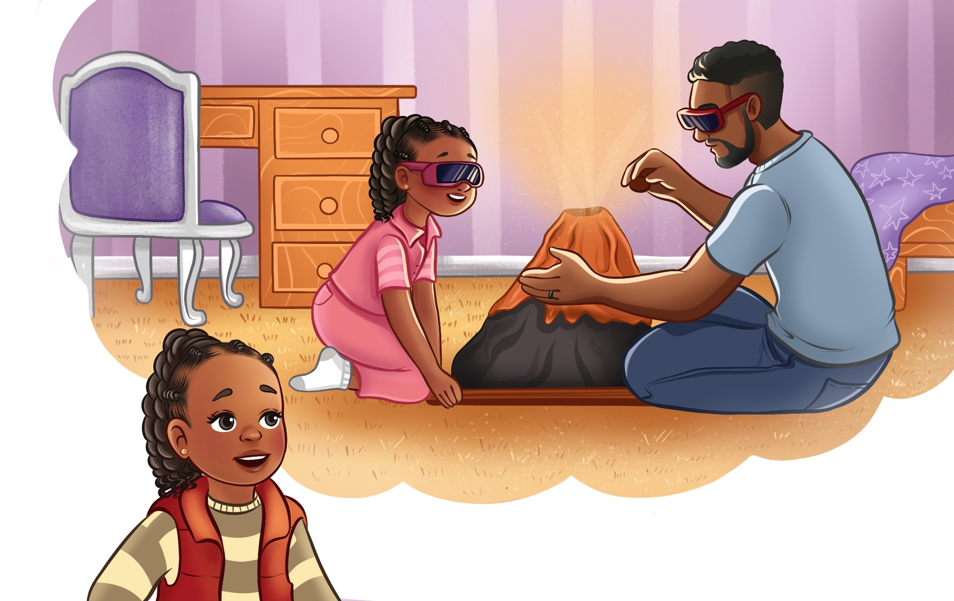
… awesome science project
“My Daddy helped me build the volcano!”

Slide 7
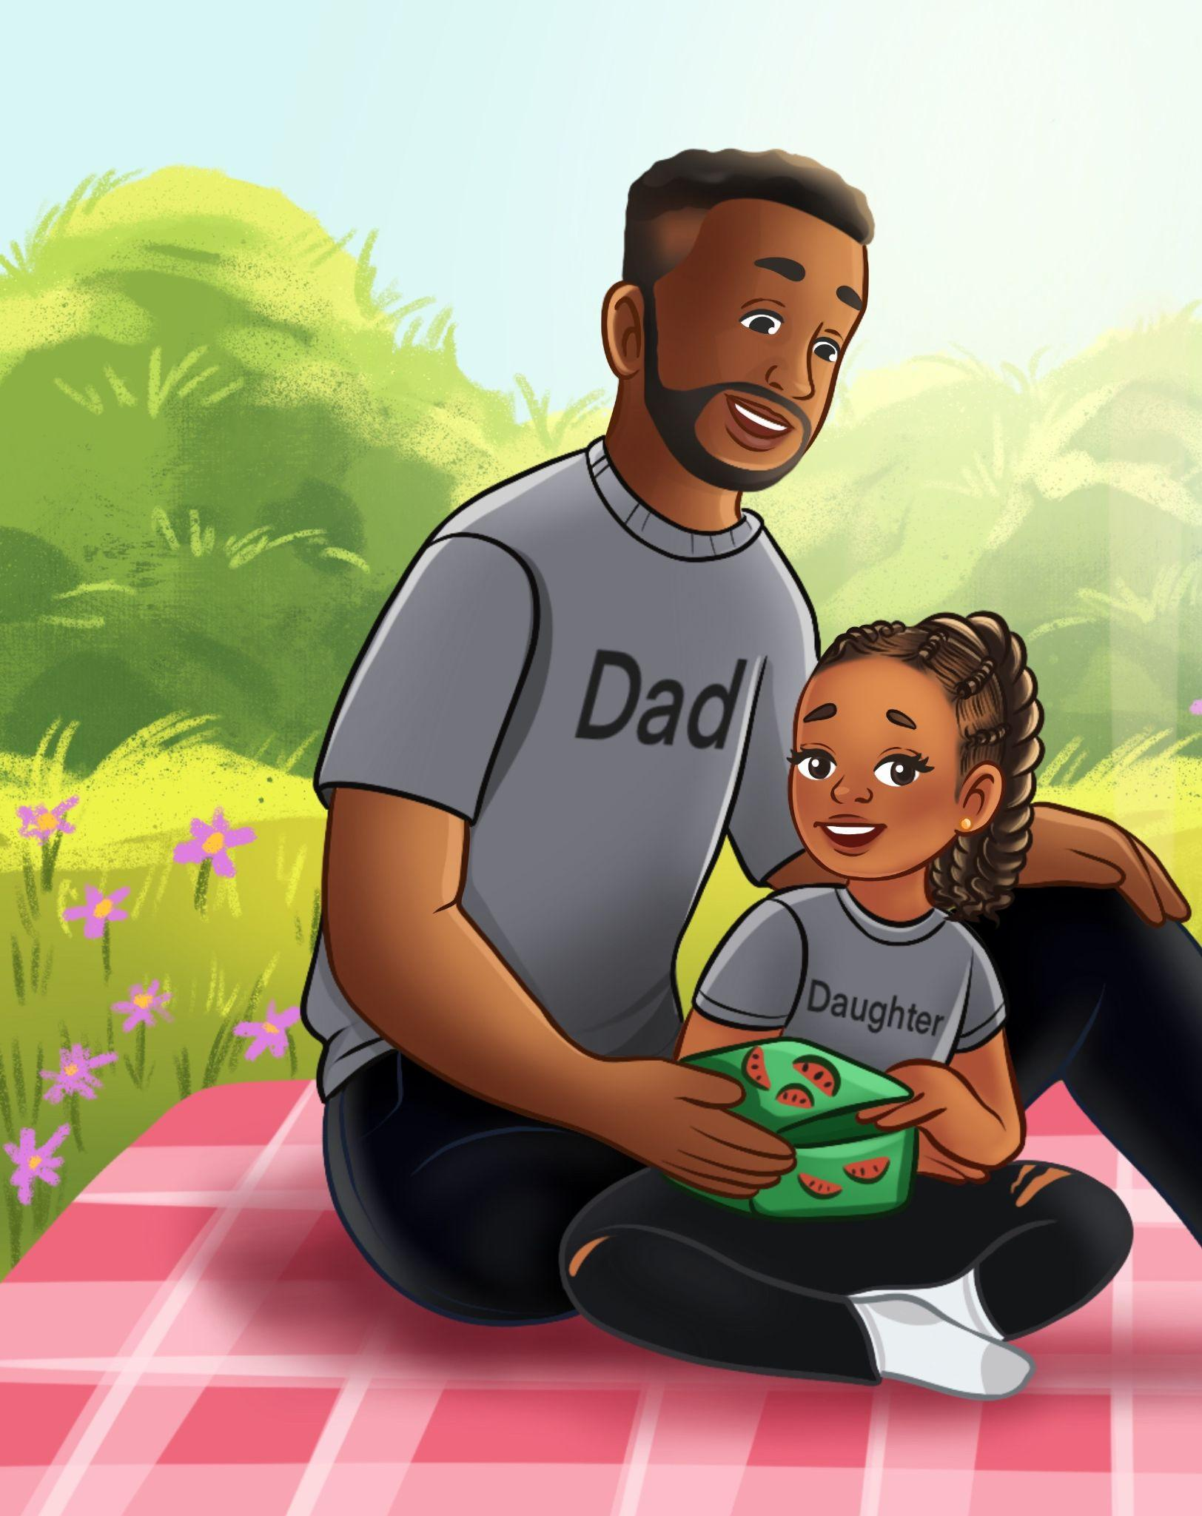
… my first picnic …
“Who made my favorite soup?”
“Who went down the big water slide with me?”
“Who drove Mommy and me to get my dog, Cocoa?”

Slide 8
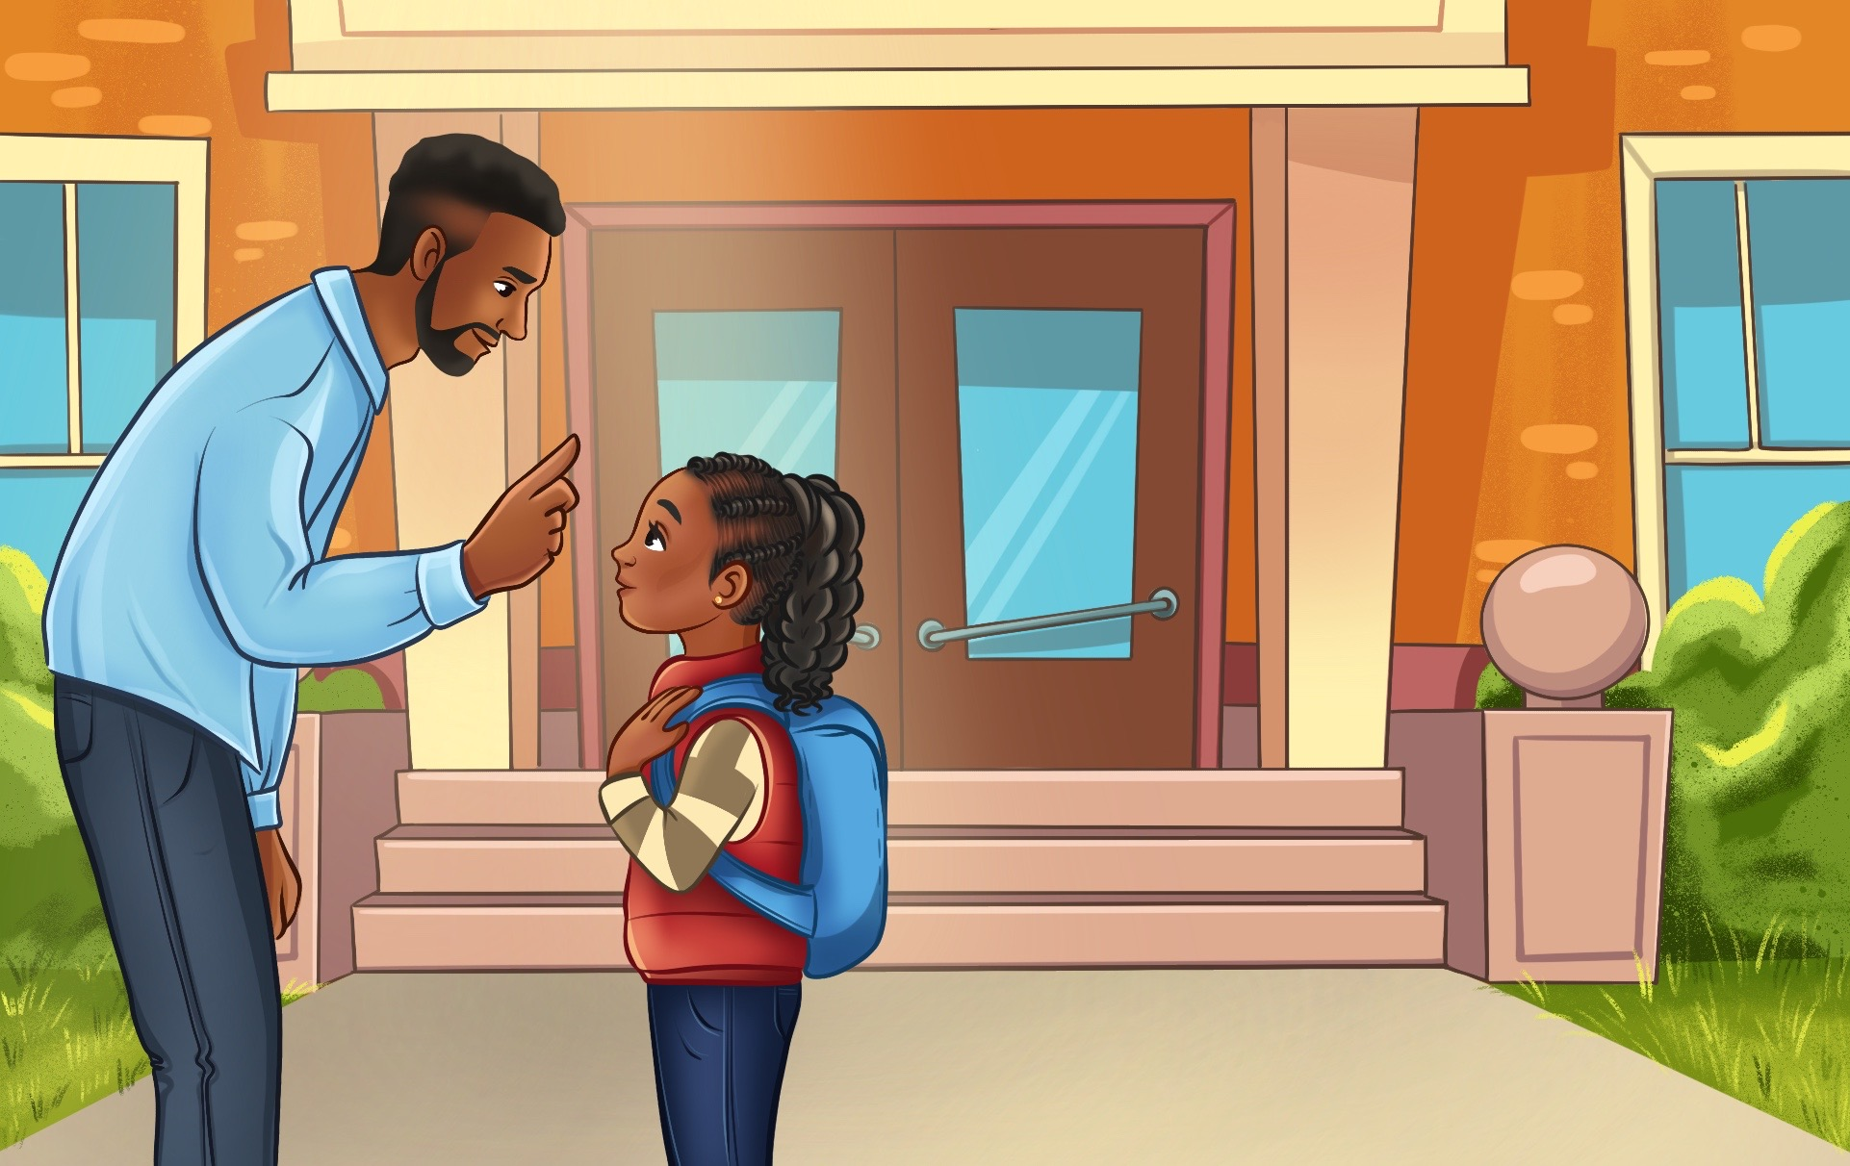
“My favorite thing to do with Daddy”
“Every day when my Daddy drops me off at school, he tells me to repeat after him. He says, ‘I am important. I am kind. I am smart. I am pretty.’ We call that our morning ritual.”

Slide 9
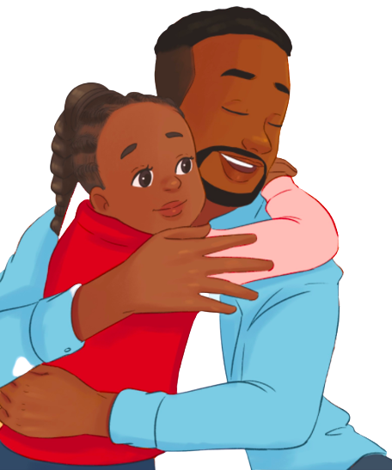
#GirlDad
What are your favorite memories with your Dad?
Notes:
Lindsey

Slide 10







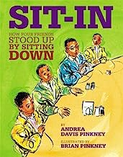
Importance of Black Authors
Notes:
Lindsey
The Importance -

Slide 11




Read Any Good Books Lately?
By Black authors?
About Black children, families, and fathers?
Book, Print, & Media Awards
Notes:
Josh

Slide 12
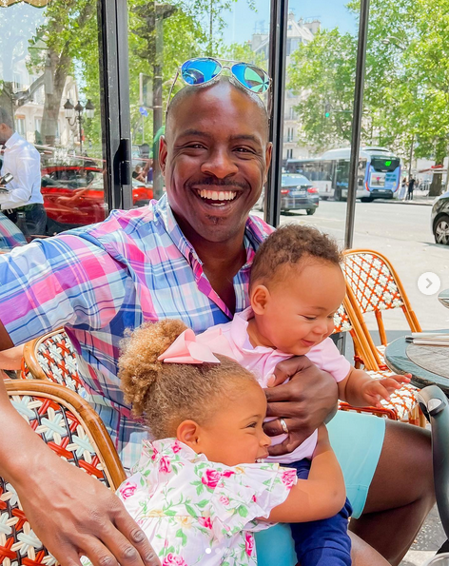
“So, Tell Me. What Bones Did You Fix?”
https://www.instagram.com/p/CteMuLXL4Ce
Dr. Marvin K. Smith
https://www.instagram.com/dr.marvinksmith/
Notes:
Josh

Slide 13

Black Men Lead their Children in Learning…
Black Fathers are actively involved in their children's lives through intentional interactions, robust caregiving duties, and rich language (Livingston & Parker, 2011)
The CDC reports that 73% of Black men talk with their children about things that happened during the day (several times a week or more)
In 2018, CDC found Black fathers were the most involved with children regardless of residential status
Fathers desire educators to view them as the stable and active men who are willing to make the needed sacrifices for their children to thrive (Wilson, 2018)
Quadean and Carter
Credit: Twenty Eight Ink
Notes:
Lindsey
Yet, Black men are often shut out of more white-centered education spaces. This presentation reviews the history of exclusion, and contrasts that with the richness of educational and cultural lessons that Black dads offer their children.

Slide 14
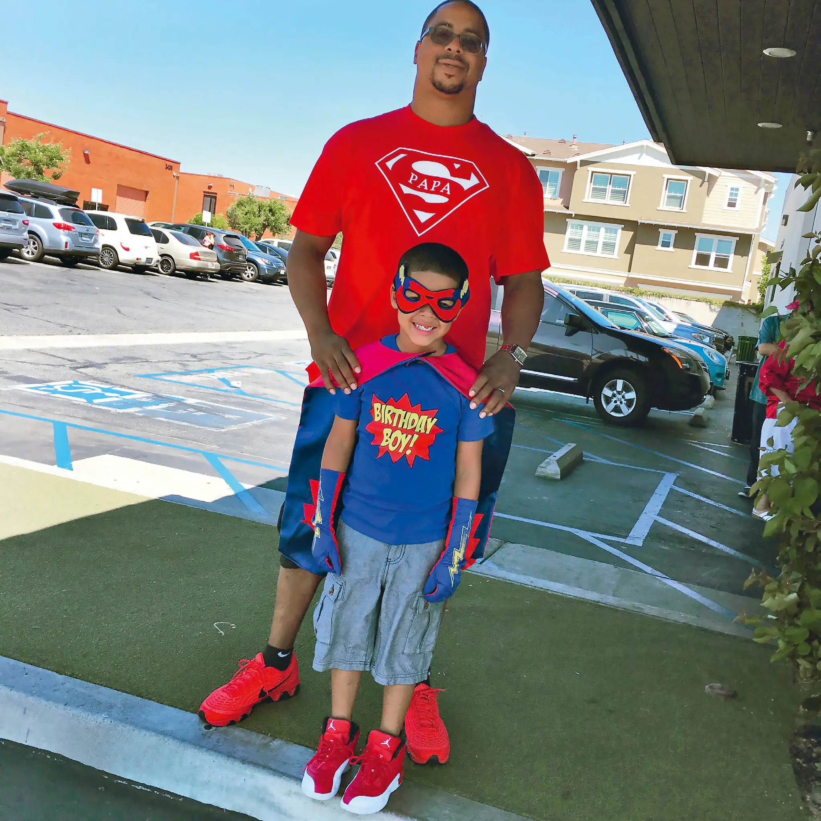
A History of Exclusion
Mainstream narratives consistently depict Black fathers from a deficit perspective (Wilson & Thompson, 2021; Wilson 2018)
Residential Status
Work Status
False narratives
Additionally, Black men have reported often being shut out of white-centered educational spaces despite the funds of knowledge they offer their young children and classmates and the active role they play.
Darnell and Darnell Jr.
Credit of Twenty Eight Ink
Notes:
Josh

Slide 15
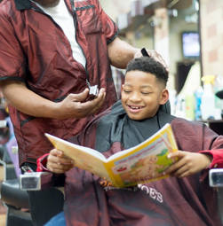
Richness of Educational Lessons that Black Dads Offer
The ‘curriculum’ of the Black barbershop is just one example of culturally situated knowledge, information, wisdom, and insight that is readily shared with the children in your classrooms, the
sons and daughters of Black dads.
https://barbershopbooks.org
Where else have you seen educational exchanges happening with Black dads and their children?
Notes:
Lindsey

Slide 16

Richness of Cultural Lessons Provided by Black Dads
1. Where else have you seen the voices of Black dads celebrated?
2. How have you shared and amplified those voices?
Listen to the richness of stories shared in so many spaces.
Example: Black Fathers’ Voices Project, Strengths, Assets, & Resilience (StAR) Lab
Notes:
Josh - ask Lindsey about StAR Lab and Dr. Shauna M. Cooper
Reflection - highlight any of the text that stands out to you? Josh will share one or two key texts.

Slide 17

The Role of Counternarratives
Explore the role of elevating counternarratives in providing a lens to support teachers in understanding Black fathers. Uncovering bias in our early childhood profession is merely the first step; now we must actively support teachers in crafting intentional anti-bias strategies to overcome resistance to learning how actively engaged Black fathers are in the lives of their children.
Creator: FatCamera
Notes:
Lindsey

Slide 18
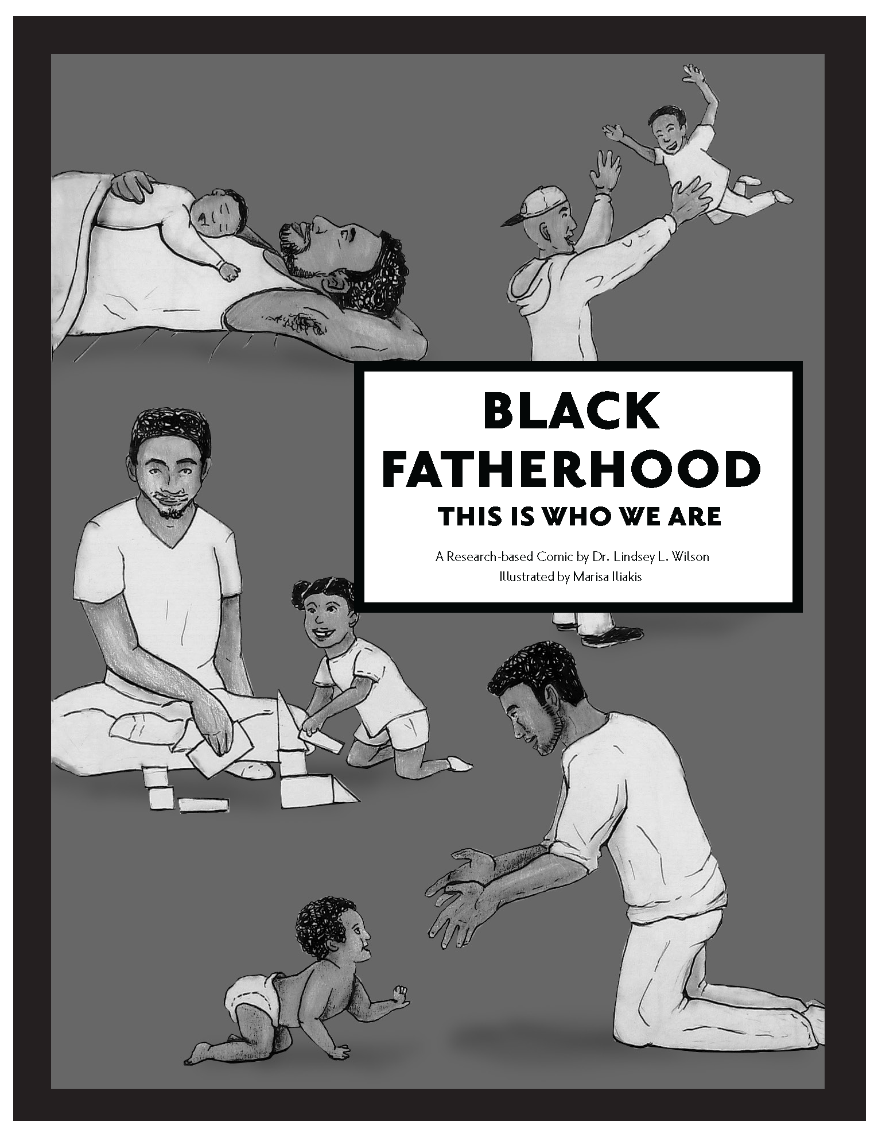
Five Practices to Foster Inclusive and Culturally Competent Classrooms
1. Examine the Curriculum
2. Build Relationships
3. Talk the Talk
4. Walk the Walk
5. Become Culturally Competent
Research-Based Comic
by Dr. Lindsey L. Wilson
Illustrated by Marisa Iliakis
Notes:
Josh

Slide 19
Action Step 1: Examine the Curriculum
Using a racial and ethnic lens, examine your curriculum for evidence of oppressive structures. Tell more of the whole story, the child’s story, by building relationships and taking into account the social and cultural contexts of each child and family.
Use ratings tools designed to help understand how your particular curriculum measures up on cultural competence. Example: Explore the Curriculum Consumer Report on the Early Childhood Learning and Knowledge Center website.
Consider tools that will help you listen to the ways you talk with young children. Find recommendations for specific ethnic and local materials to support or expand your curriculum.
Notes:
Lindsey
Bullet #B - which offers information about how different curricula relate to Head Start Program Performance Standards. One of the criteria specifically examines and offers a rating for cultural responsiveness.

Slide 20
Reflection 1: Examining Curriculum
How are various races and ethnicities represented in your setting? (While this starts at the obvious, such as books, look for more subtle and hidden materials and mannerisms.)
How can you intentionally supplement your curriculum to make it more inclusive?
How do your mannerisms coincide or conflict with how children are spoken to in their homes?
Notes:
Josh

Slide 21
Action Step 2: Build Relationships
Intentionally connect with African American fathers by taking time to get to know who they are, what they value and are concerned about, and what they enjoy doing with their children.
Using a strengths-based approach when learning about African American fathers, Cooper et al.’s 2020 study highlights fathers’ concerns about how racism will impact their children and the strategies fathers use to help them cope and thrive.
B. Rather than telling fathers how to be involved in school, seek input on the most effective way that schools can operate.
Notes:
Lindsey
(see also thestarlab.org/wpcontent/uploads/2020/07/black-fathers-voices-project-2.mp4).

Slide 22
Reflection 2: Build Relationships
How do you build relationships with Black fathers? How does it differ from the ways that you connect with fathers or mothers of other races or ethnicities?
How do school personnel recognize and acknowledge the influence of race and racism in Black fathers’ parenting?
Notes:
Josh
While there may be culturally relevant styles, every dad parents differently. Ask the fathers in your setting how they parent, and share with them your genuine respect and curiosity toward the lessons they identify as critical for their children. You might find that after learning to listen, you have begun to talk the talk with each father, sometimes in unexpected and unfamiliar places.

Slide 23
Action Step 3: Talk the Talk
Dig deep into the funds of knowledge attained in barbershops. To learn more about culturally relevant, community-based education programs that take place there, visit www.barbershopbooks.org
Mirror the enriching learning spaces that children are accustomed to outside of your setting. Ask fathers for their vision in building a play area that mimics barbershops.
Seek the support of Black fathers to understand what is needed to make the classroom a safe space where their children can learn.
Notes:
Lindsey

Slide 24
Reflection 3: Talk the Talk
What is the selection criteria for your settings’ (books and other materials)? How many books are written or illustrated by authors of color? Do children see themselves in the books, and is there alignment with the books they may be exposed to in their home and community contexts?
What opportunities are available to tap into the wealth of knowledge that happens at barbershops and to bring it directly into the classroom in ways that allow fathers to be the subject matter experts?
Notes:
Josh

Slide 25
Action Step 4: Walk the Walk
Enter into the world of the child and their family. Find ways to engage and participate in how Black fathers parent their children. This shift is more than words; greater than actions. There are profound transformations that occur when teachers actively pursue a greater understanding of other cultures, other families, and other fathers.
Examine the cultural experiences and household norms of the Black fathers in your community. Find ways to access and enter into the richness of diversity in the parenting exhibited there.
Notes:
Lindsey
It may be very different, or it might be just a nuanced shift from ways more familiar to what teachers are accustomed to.

Slide 26
Reflection 4: Walk the Walk
No one is immune to bias. Take time to explore what you consume about Black fathers via television, radio, curriculum, and other sources. How may this impact the relationships you create with these fathers?
What can you change or do more of in your classroom because of insights learned from home visits?
Notes:
Josh

Slide 27
Action Step 5. Becoming Culturally Competent
Representation matters in teaching, learning, and relationships. Be intentional about including all fathers in your program. Ask them in as many different ways as it takes to include them.
Analyze the images of Black fathers that families receive from your setting. Include not just pictures, but expectations and conditions for engaging.
Notes:
Lindsey

Slide 28
Reflection 5: Becoming Culturally Competent
How does an increasing awareness of race and racism affect your appreciation of your culture and upbringing?
How do you actively recognize the positive role models that Black fathers represent?
Notes:
Josh
The best step to take to help the children of Black fathers is to boldly step through the sliding glass door and become competent in the cultural context of each child.

Slide 29
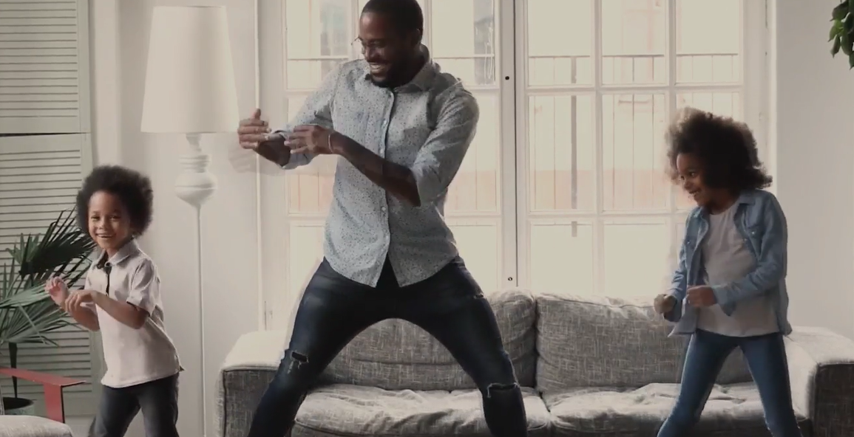
Closing The Deal… End With A Story
Your story, told by you, about Black dads and how they belong in the learning communities of their children, they belong in your schools and classrooms.
StAR Labs
Notes:
Josh

Slide 30
June 3, 2024
Establishing Learning Communities That Welcome Black Dads
Lindsey Wilson, PhD Josh Thompson, PhD
Notes:
Josh

Slide 31
This presentation is based on our recently published article:
Wilson, L. & Thompson, J. (2022). Welcoming Black Dads:
Action Steps and Reflections on Becoming Culturally
Competent. Young Children, 77(4), 26-34.
https://www.drlindseywilson.com/
http://faculty.tamuc.edu/jthompson/abar
Notes:
Lindsey

