Slide 1
Ages & Stages, and Beyond A New Framework:
Developmental Cascades
Josh Thompson, TAMU-Commerce
Zlata Stanković-Ramirez, TWU
Notes:
Zlata

Slide 2
Developmental Cascades provides a unifying framework to understand change and growth, and how professionals develop their view of the child
Ages & Stages is a robust description of child development.
Notes:
Zlata

Slide 3
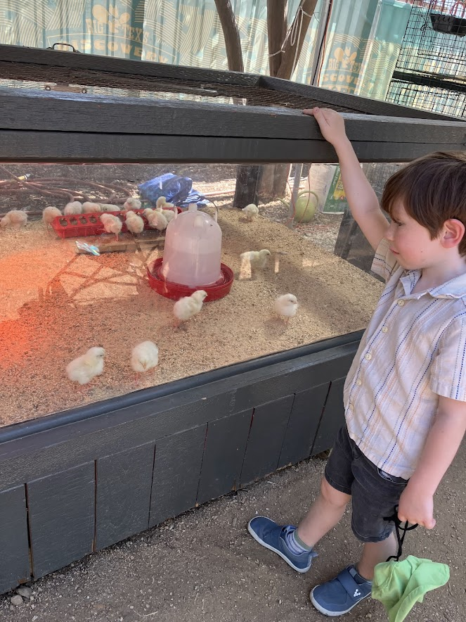
Turn & Talk
What theories &/or approaches inform your life with young children?
Talk with your neighbor, introduce yourself, tell what you do, and WHY?
Notes:
Rachael
Josh close with song “Hello”

Slide 4

theorists
Someone who develops an abstract idea or set of ideas about a particular subject to explain it.
e.g., Piaget, Vygotsky, and Gardner.
Notes:
Zlata

Slide 5
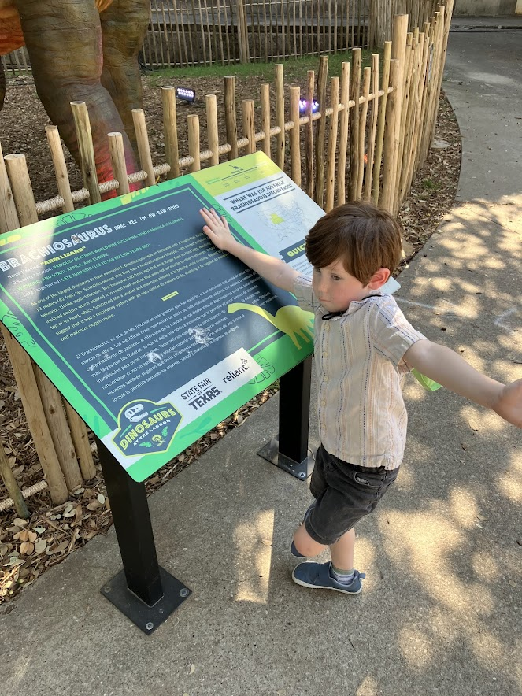
approachists
Someone who attempts to understand the root cause of something and use that data to predict when that event will happen again
e.g., Montessori, Malaguzzi and Steiner.
Notes:
Zlata

Slide 6

Theorists & Approachists
Write down on post-it notes:
Current Job Title(s)
Name a theorist or approachist that informs your work, personally.
Name a curriculum you use currently, if any.
Notes:
Sicily

Slide 7

Theorists & Approachists
Post your note on the chart paper along the horizontal axis, somewhere between “Nature” on the left, and “Nurture” on the right, “Maturationist” on the left, and “Behaviorist” on the right.
Notes:
Josh

Slide 8
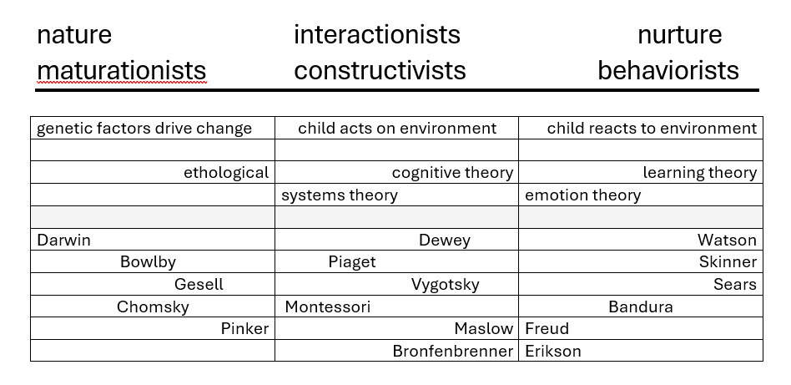
Theorists & Approachists:
A Linear View
Notes:
Josh

Slide 9
Session objectives
Review our “Why?”
Examine changes in DAP
Explore Developmental Cascades
Consider Observation anew
Re-examine our “Why?”
Notes:
Zlata

Slide 10
Changes in Developmentally appropriate practice
Notes:
Zlata 10-13

Slide 11
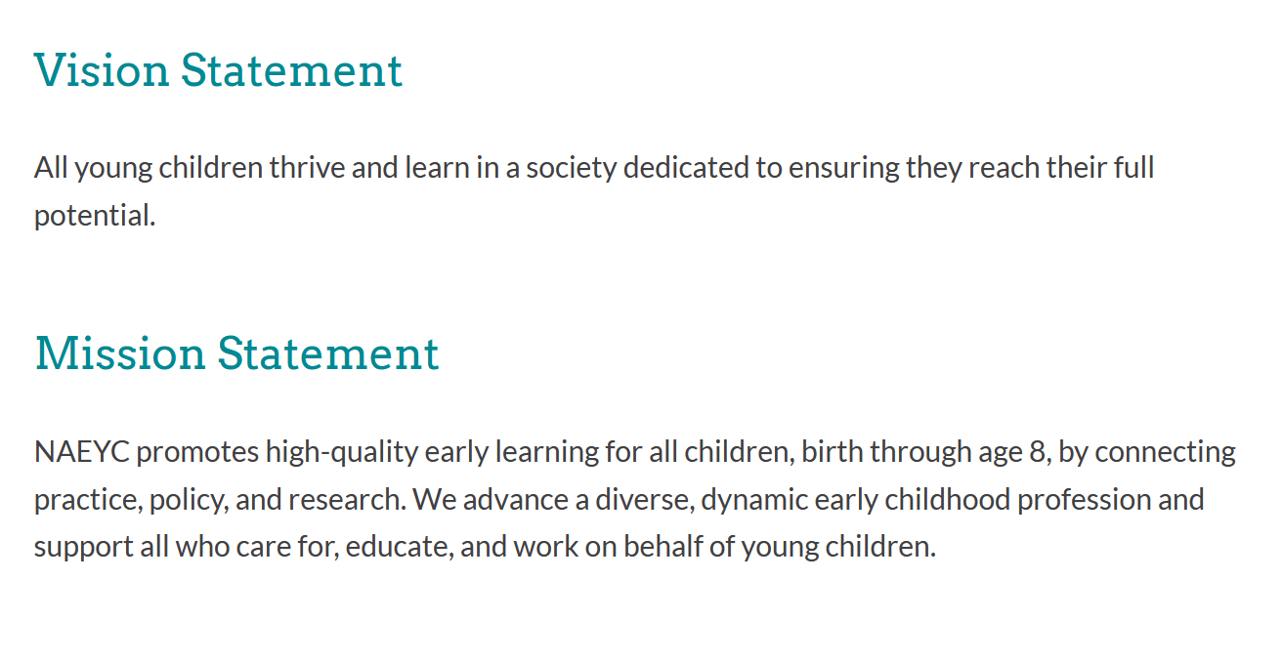
National Association for the Education of Young Children (NAEYC)
Notes:
Zlata 10-13

Slide 12
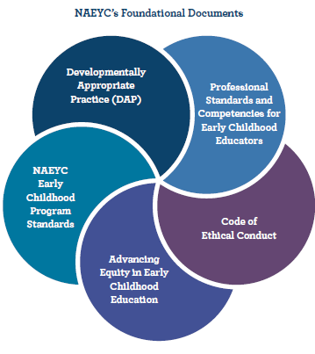
Developmentally Appropriate Practice
DAP is the early childhood education framework that many early childhood education programs use as their pillars for creating quality care.
Notes:
Zlata 10-13

Slide 13

First Three editions
* Position statements
* Publications
1987: To prevent “push down” curriculum, 2 core considerations
1997: Revised, 3 core considerations Diversity: social and cultural context for Child, Educator, and Program
2009: “Best practice” Typically developing children, Assessing normative instructional practices Deemphasized cultural contexts
Notes:
Zlata 10-13

Slide 14
Turn & talk
When did you first hear about DAP?
What does DAP look like to you in classrooms and learning environments?
Notes:
Rachael
Josh – close with song “Clap”

Slide 15

Developmentally Appropriate Practice in Early Childhood Programs – 4th Ed.
Position Statement 2020
Publication 2022
* Shift in emphasis, away from standards-based and towards a transformative view of the young child
* Instead of Ages and Stages, Overlapping Waves
* Reemphasizing diversity, the unique individual
Notes:
Zlata 15-16

Slide 16
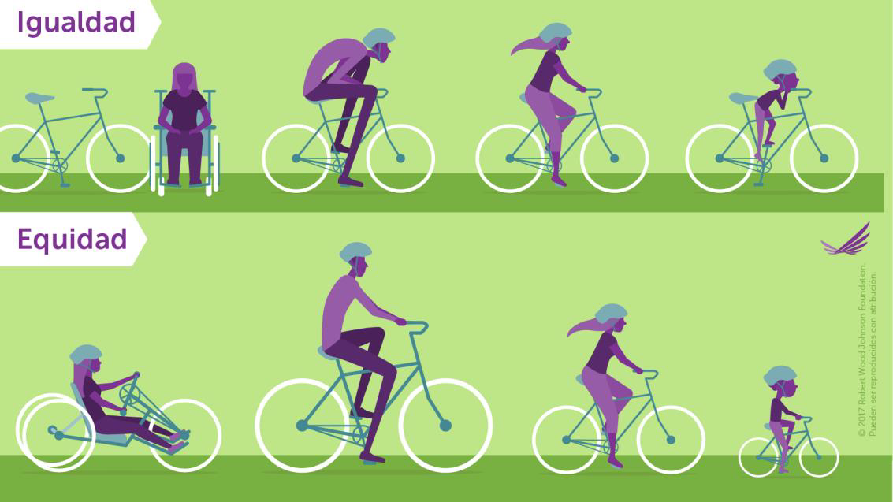
Advancing Equity in Early Childhood Education (2019) NAEYC
All children have the right to equitable learning opportunities that help them achieve their full potential as engaged learners and valuable members of society.
Notes:
Zlata 15-16

Slide 17
Our study of Dap
Stanković-Ramirez, Z. & Thompson, J. (2018). Rethinking developmental domains to improve classroom observations. Texas Child Care Quarterly, 42(2), 20-27.
Thompson, J., & Stanković-Ramirez. (2021). What early childhood educators know about developmentally appropriate practice. Phi Delta Kappan, 103(2), pp. 20-23.
Stanković-Ramirez, Z., & Thompson, J. (2022). A new view of Developmentally Appropriate Practice: What early childhood educators know about waves, individuals, and equity. TEPSA Leader: Texas Elementary Principals and Supervisors Association 35(2), 1-7.
Notes:
Josh 17-18

Slide 18

Please take our Survey:
"What EC Educators Know About DAP"
The purpose of this study is to discover what ECCE professionals know about developmentally appropriate practice (DAP) in general, and specifically about recent changes in the 2020 revision. Your part in the study will be to respond to 5 short answer questions about the changes in DAP. It will take you about 30 minutes to review materials about DAP, and another 30 minutes answering the 5 short answer prompts.
http:faculty.tamuc.edu/jthompson/DAP
Notes:
Josh 17-18

Slide 19

EVERY CHILD IS UNIQUE
“It’s a mistake to try to fit children into preexisting templates, insisting that every child achieve specific milestones at specific ages.”
Thompson & Stanković-Ramirez, 2021, p. 21
Notes:
Zlata 19-22

Slide 20

Waves and cycles
“The waves of development, the ebb and flow of growth and processing, acquisition and reconsideration, all together map a process of typical child development, and attending to these waves empowers educators of children of all ages to go with the flow.”
Thompson & Stanković-Ramirez, 2022, p. 5
Notes:
Zlata 19-22

Slide 21

Waves and cycles
“The notion of ‘stages’ of development has limited utility; a more helpful concept may be to think of waves of development that allow for considerable overlap without rigid boundaries.” NAEYC 2020, 10
“The concept of stages does not accurately reflect the way development takes place …
“These waves consist of spurts of development interwoven with periods of little apparent growth.” NAEYC 2022, 36
http://faculty.tamuc.edu/jthompson/co-lab
Notes:
Zlata 19-22

Slide 22

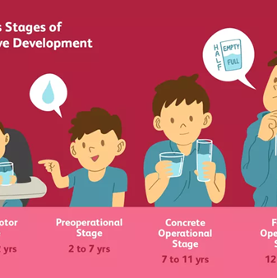
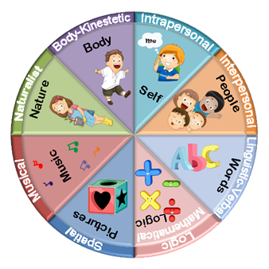
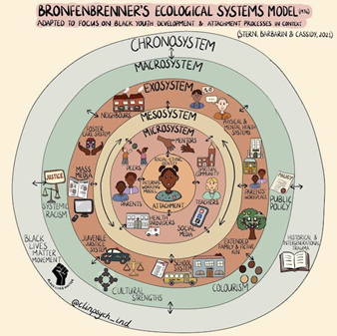
Theories of Development
Planes of Development | Ages & Stages | Multiple Intelligences | Ecological Systems
Montessori | Piaget, Erikson | Gardner | Bronfenbrenner
Notes:
Zlata 19-22

Slide 23
Turn & Talk
How do Theories of Development affect teachers’ Image of the Child?
How does learning about Theories of Development help teachers change and grow?
Notes:
Rachael
Josh – close with song “I Like It Here in Frisco”

Slide 24
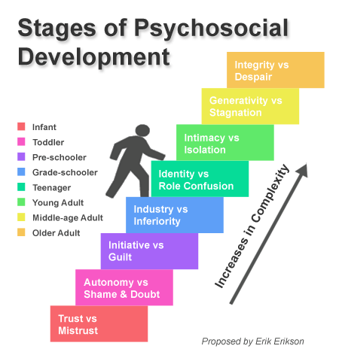
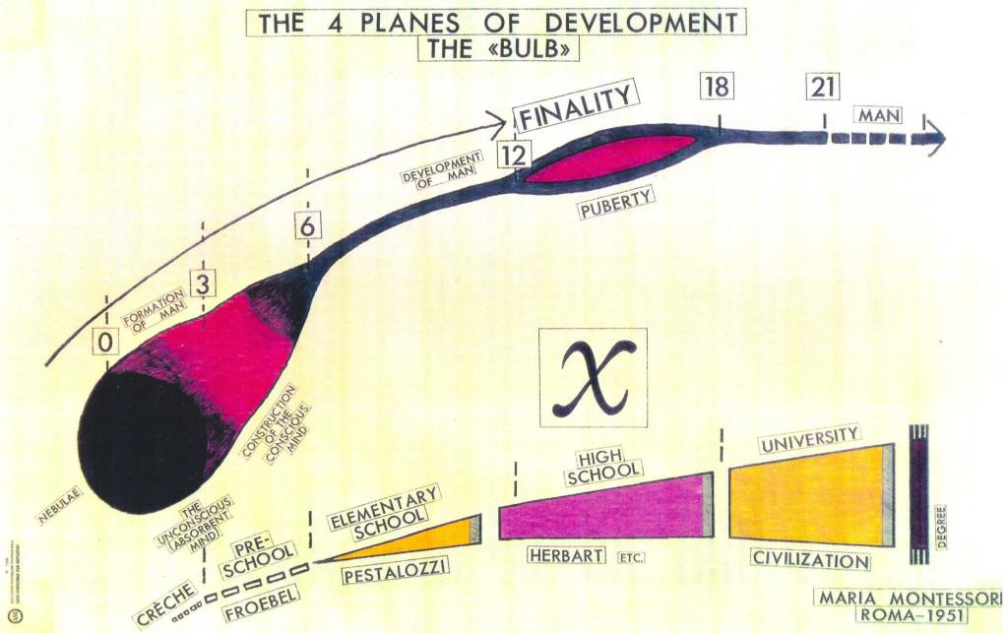
Paradigm Shift
Notes:
Zlata 24-25

Slide 25
“A simple liberating thought came to our aid, namely that things about children and for children are only learned from children. Follow the child.” Malaguzzi (1998, 51)
Notes:
Zlata 24-25

Slide 26
Developmental cascades
Insights gleaned from Developmental Psychology
Siegler 1996
Masten & Cicchetti 2010
Oakes & Rakison 2020
Tamis-LeMonda & Lockman 2023
Notes:
Josh, 26-32

Slide 27
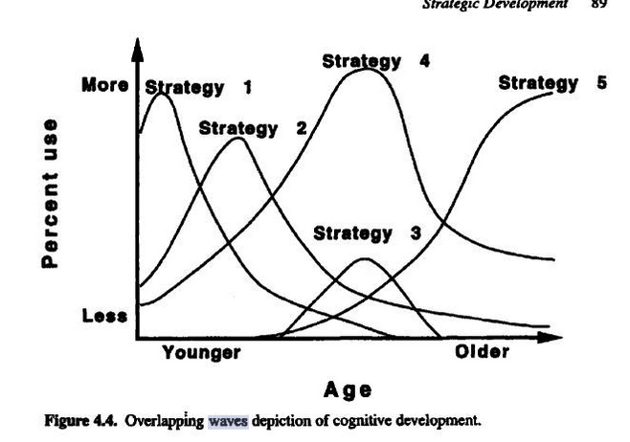
Overlapping waves
Siegler 1996
Notes:
Josh, 26-32

Slide 28

Developmental cascades
Masten, A.S., & Cicchetti, D. (2010). Developmental Cascades. Development and Psychopathology, 22(3), 491-495.
Notes:
Josh, 26-32

Slide 29

Developmental cascades
“A cascade can be used as a metaphor for thinking about development. Abilities begin at the top of the cascade and move down along different trajectories depending on which rocks and obstacles are encountered along the way. All drops of water, or developing abilities, end up in the pool below, but the particular position in the pool depends on the path traveled, which reflects the events and objects encountered along the way.”
Oakes & Rakison, 2020, p. 103
Notes:
Josh, 26-32

Slide 30

Developmental cascades
“Children develop along any number of paths depending on factors such as how much freedom they are given to move, their relative size, the kind of caregiving they receive, and how language is spoken to them, and much more. It’s important to not consider differences as a way to identify deficits… understand how experience influences the shape of the cascade.”
Tamis-LeMonda & Lockman, 2023
Notes:
Josh, 26-32

Slide 31

Developmental cascades
In child development, the concept of developmental cascades refers to the domino effect of early experiences on later development.
Bi-directional – early milestones influence later development, and later development can reinforce or reshape earlier skills
Impact across domains – development occurs within a single domain, or across multiple domains
Cumulative effects – small success or early struggles lead to larger advantages or disadvantages later.
Not predetermined – development is a path of influence, not fixed destiny
Notes:
Josh, 26-32

Slide 32

Developmental cascades
Constraints –
Shaping Factors
Biological constraints – Genetic makeup, brain development, physical capabilities
Environmental constraints – SES, family dynamics, community resources
Experiential constraints – Life experiences, resiliency
Notes:
Josh, 26-32

Slide 33

Developmental cascades
3 Vignettes
NAEYC (2022) Appendix A: DAP in Action: Educator Snapshots and Reflections. DAP in Early Childhood Programs Serving Children from Birth Through Age 8 (4th ed.), pp. 281–285.
A.5 Studying Birds in the Spring Amy Blessing | A.7 “A Monster, I’m Not Afraid of Anything at All” Ron Grady | A.8 The Name Ron Grady
Notes:
Rachael
Josh closes with “Fido”

Slide 34

Observation tools
Notes:
Josh 35-42

Slide 35
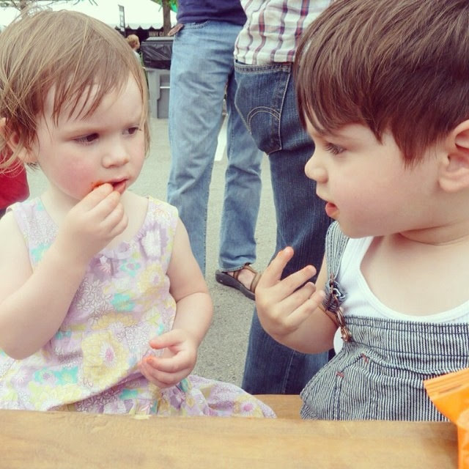
Norm & Norma
Nope, this child doesn’t exist, not in your class, not in my family. Become aware of how your idealized, mental image of the child who ‘should be’ could potentially interfere with your ability to see the child who is there in front of you. Check your bias.
Notes:
Josh 35-42

Slide 36
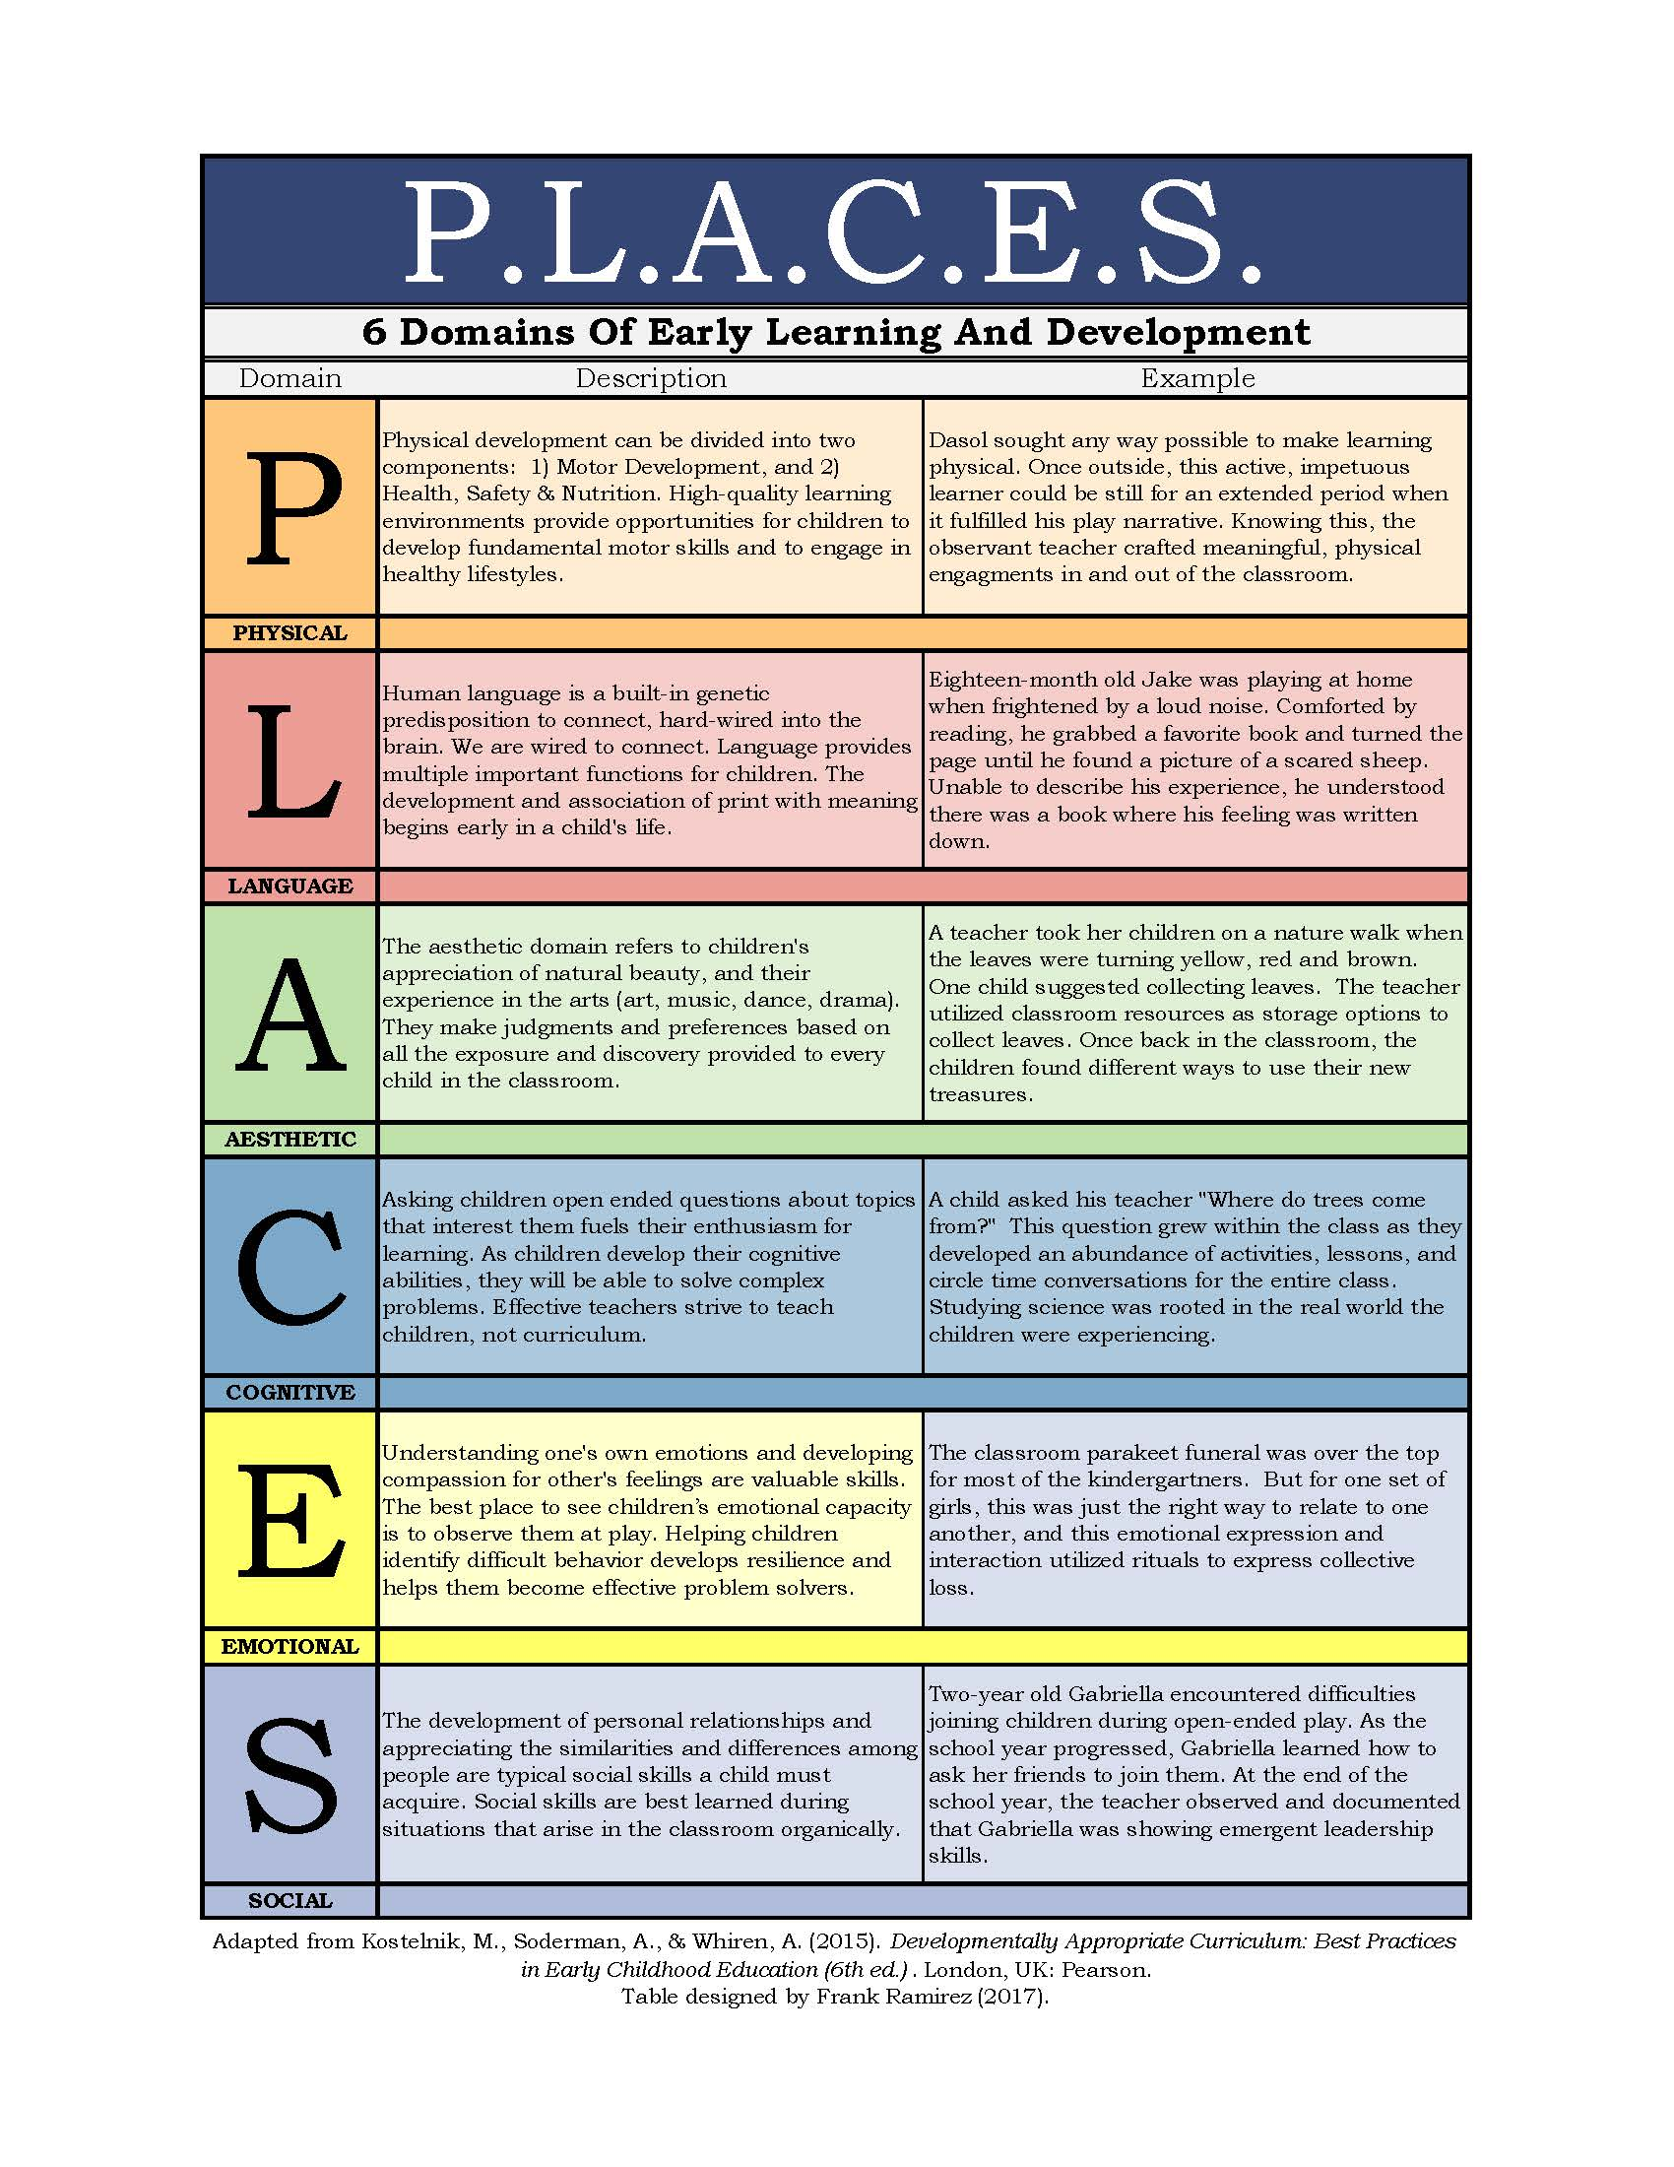
P.l.a.c.e.s.
Six Domains of Development
Notes:
Josh 35-42

Slide 37


Infant toddler preschooler kindergartner primary school age pre-teen adolescent
Notes:
Josh 35-42

Slide 38
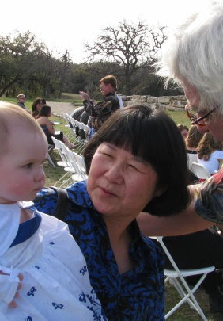
Kid watching
Observing ongoing development through daily activities that are integral to instruction
Owocki & Goodman (2002)
Notes:
Josh 35-42

Slide 39

Honoring the Moment in Young Children’s Lives:
Observation, Documentation, and Reflection
by Ron Grady 2024
https://www.childology.co/
Notes:
Josh 35-42

Slide 40
Ways of being with children as observer
Image of the children as full human beings
Meaningful mundane
Proximity
Notes:
Josh 35-42

Slide 41
Ways of being with children through documentation
Ethnography
Etic and Emic
Notes:
Josh 35-42

Slide 42
Ways of being with children in reflection
Embracing the possibilities of proximate gaze
Advocacy as relationship
Interrogating Cultures
Notes:
Josh 35-42

Slide 43

Turn & talk
In what ways can Developmental Cascades transform a teacher’s observation protocols?
Notes:
Rachael
Josh – close with song “Clap”

Slide 44
Developmental Cascades provides a unifying framework to understand change and growth, and how professionals develop their view of the child
Ages & Stages is a robust description of child development.
Notes:
Zlata

Slide 45
Session objectives
Review our “Why?”
Examine changes in DAP
Explore Developmental Cascades
Consider Observation anew
Re-examine our “Why?”
Notes:
Zlata

Slide 46
Developmental cascades
In child development, the concept of developmental cascades refers to the domino effect of early experiences on later development.
Bi-directional – early milestones influence later development, and later development can reinforce or reshape earlier skills
Impact across domains – development occurs within a single domain, or across multiple domains
Cumulative effects – small success or early struggles lead to larger advantages or disadvantages later.
Not predetermined – development is a path of influence, not fixed destiny

Slide 47
Developmental cascades
Constraints –
Shaping Factors
Biological constraints – Genetic makeup, brain development, physical capabilities
Environmental constraints – SES, family dynamics, community resources
Experiential constraints – Life experiences, resiliency

Slide 48

Thank you
Ages, Stages & BEYOND! A New Framework:
Developmental Cascades
Session Speakers:
Josh Thompson and Zlata Stanković-Ramirez
Session Date: 10-11-2024
Session Time: 1:00 PM – 2:30 PM

Slide 49
Co-lab collaboration of nine international, interdisciplinary, intergenerational research scholars
Catalina Murcia, Casa de Paz Montessori, Dallas
Daniela Uribe Montserrat, Tecnológico de Monterrey
Danielle McLellan-Bujnak, Respectful Care® for Nannies & NCS
Josh Thompson, Texas A&M University-Commerce
Marta Mercado-Sierra, Texas Woman’s University, Denton
Mary Harper, Texas A&M University-Corpus Christi
Melissa Heinrich, The University of Texas at Dallas
Rachael Rose, Texas Woman’s University, Denton
Zlata Stanković-Ramirez, Texas Woman’s University, Denton

