Slide 1


Developmental Cascades
Daniela A. Uribe Montserrat, MPA
Monterrey, NL, MX
Josh Thompson, PhD
Commerce, Texas, US
Notes:
Daniela
Josh – sing “Hello”

Slide 2

* PROVOCATIONS – a Survey
* NAEYC (2020) DAP. 4th ed.
* THE TEACHER’S IMAGE OF THE CHILD
* DEVELOPMENTAL CASCADES
OBJECTIVES
Notes:
Josh

Slide 3
Provocations – a Survey
As a part of our ongoing process to continuously improve quality, we are developing a survey designed to assess your experience. We appreciate your willingness to help us pilot test the survey and provide us some feedback on your understanding and perception of the survey items. Your individual responses in the pilot test phase will not be reported to anyone except those who are designing the survey.
Click here for SURVEY
Notes:
Daniela

Slide 4


Encuesta
Inglés
Español
Notes:
Daniela

Slide 5


Daniela y Dr. JT
Daniela:
Estudiante de doctorado del programa de innovación educativa del Tecnológico de Monterrey, Mexico
De Caracas, Venezuela
Mamá de dos (2 y 5 años)
Sociólogo y Maestría en Administración Pública
Políticas educativas, sociales, evaluación de programas.
Josh Thompson
Profesor de educación en la primera infancia en Texas A&M Commerce.
PhD. en Humanidades y Linguística
Abuelo de 12 nietos
Notes:
Daniela
Josh

Slide 6
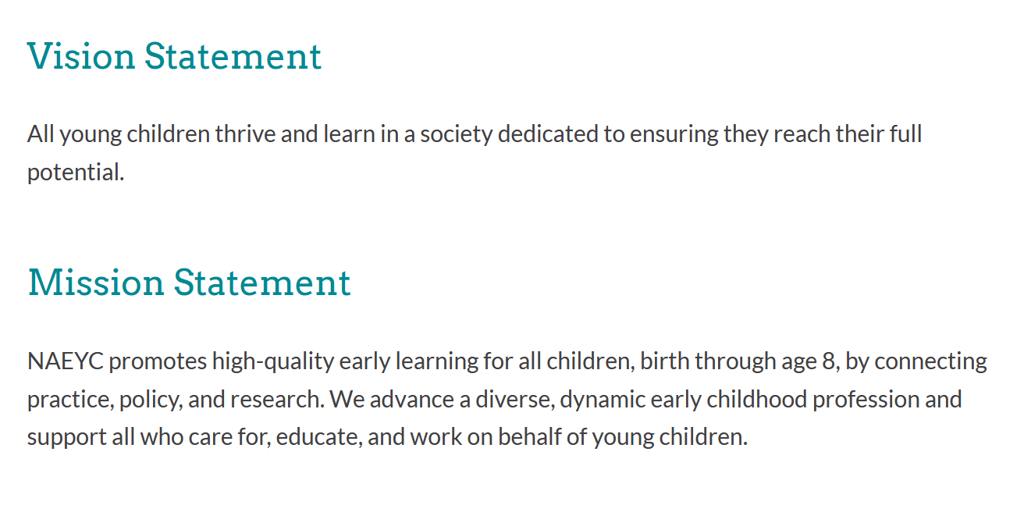
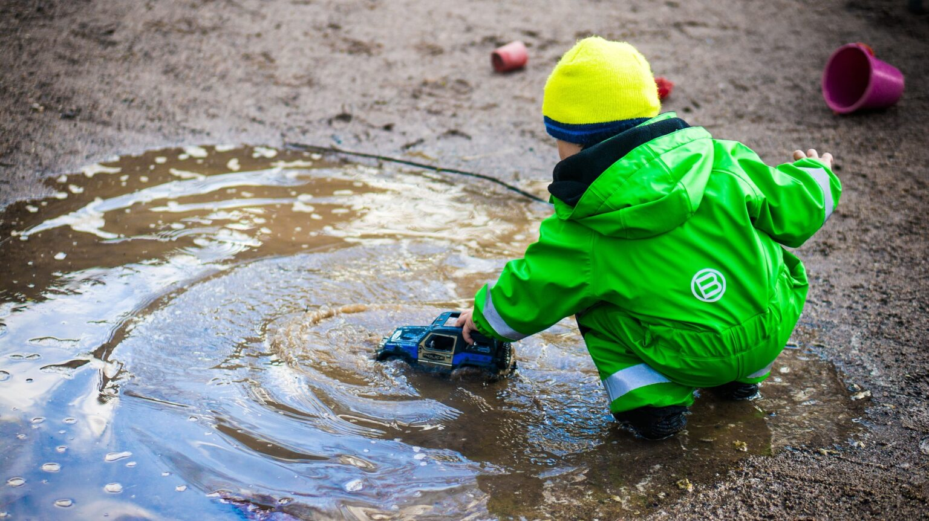
National Association for the Education of Young Children (NAEYC)
Notes:
Josh

Slide 7
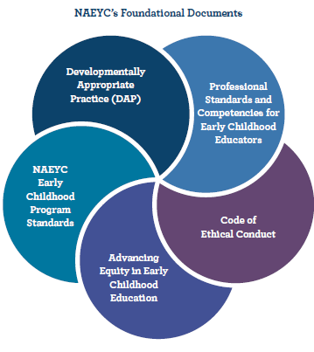
Five Documents to Consider
DAP is the framework for creating quality care and education.
Notes:
Josh

Slide 8

FIRST 3 editions
1987: To resist “push down” curriculum from elementary to preschool level, and included 2 core considerations
1997: Revised to include the third core consideration to address diversity to include the socio-cultural context for each, Child, Educator, Program
2009: Identify “Best practice” and what is not
Typically developing children
Tool to assess normative instruction
De-emphasized cultural contexts
Leaned in toward “best practice” for all
Notes:
Daniela

Slide 9
Turn and Talk
When did you first hear about DAP?
How do you see DAP in Texas classrooms and learning centers?
Notes:
Josh – song “Clap”

Slide 10


Developmentally Appropriate Practice in Early Childhood Programs Serving Children from Birth Through Age 8,
Fourth Edition
Major shift in emphasis, away from standards-based and towards a transformative view of the young child
Instead of Ages and Stages, Waves and Cycles
Reemphasizing the diversity and uniqueness of individual
Notes:
Josh

Slide 11

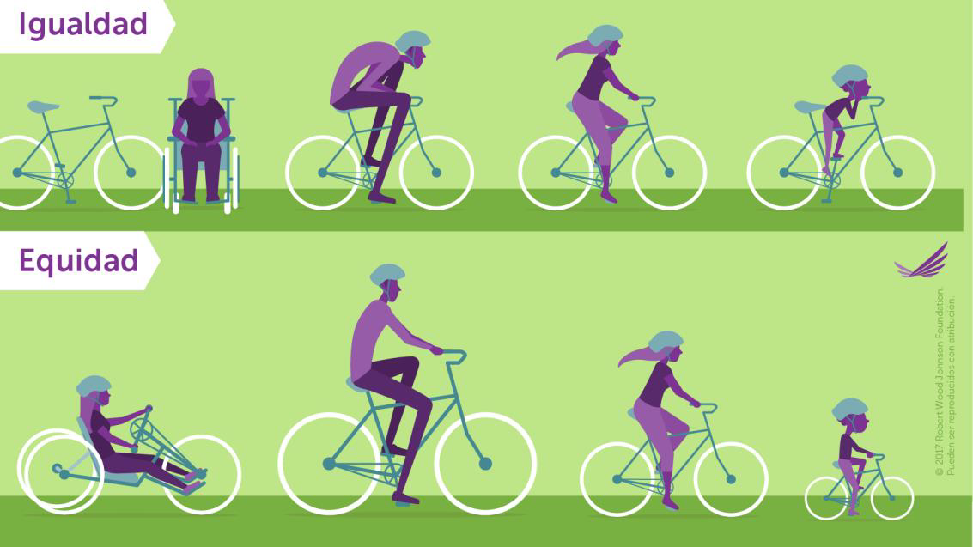
DAP IS EQUITY
Notes:
Daniela

Slide 12

EVERY CHILD IS UNIQUE
“It’s a mistake to try to fit children into preexisting templates, insisting that every child achieve specific milestones at specific ages.”
Thompson & Stanković-Ramirez, 2021, p. 21
Notes:
Daniela

Slide 13

WAVES
“The notion of ‘stages’ of development has limited utility; a more helpful concept may be to think of waves of development that allow for considerable overlap without rigid boundaries.”
(NAEYC 2020, 10)
“The concept of stages does not accurately reflect the way development takes place … These waves consist of spurts of development interwoven with periods of little apparent growth.”
(NAEYC 2022, 36)
Notes:
Josh

Slide 14

Waves
“The waves of development, the ebb and flow of growth and processing, acquisition and reconsideration, all together map a process of typical child development, and attending to these waves empowers educators of children of all ages to go with the flow.”
Thompson & Stanković-Ramirez, 2022, p. 5
Notes:
Daniela

Slide 15

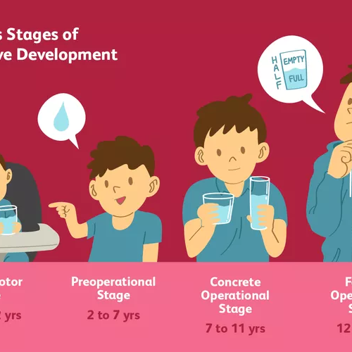
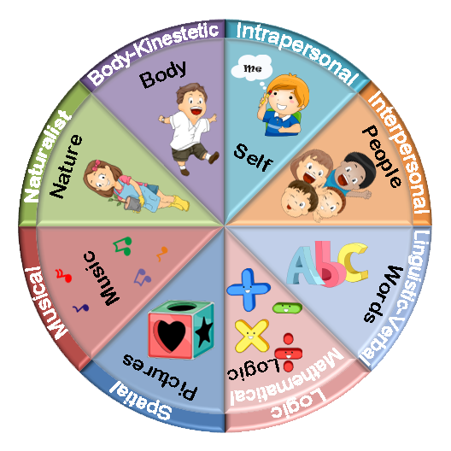
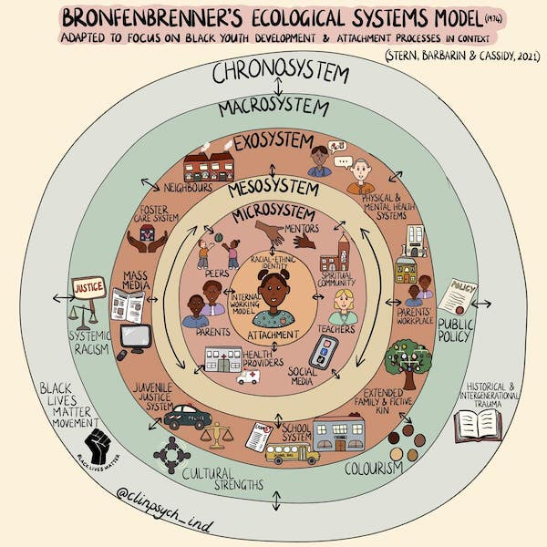
Theories of Development
Planes, Ages and Stages
Developmental Cascades
Waves and Cycles
Planes of Development
Ages and Stages
Multiple Intelligences
Ecological Systems
Montessori
Piaget, Vygotsky, Erikson
Gardner
Bronfenbrenner
Notes:
Josh

Slide 16
Turn and Talk
Planes, Ages and Stages
Developmental Cascades
Waves and Cycles
How do Theories of Development affect teachers’ Image of the Child?
How does learning about Theories of Development help teachers change and grow?
Notes:
Daniela
Josh – song “I Like It Here in Arlington”

Slide 17

“A simple liberating thought came to our aid, namely that things about children and for children are only learned from children.”
Follow the child.
Malaguzzi (1998, 51)
Notes:
Josh

Slide 18


Developmental Cascades
DC
Insights from Developmental Psychology
Society for Research in Child Development SRCD
Masten & Cicchetti (2010)
Oakes & Rakison (2020)
Tamis-LeMonda & Lockman (2023)
Notes:
Daniela

Slide 19
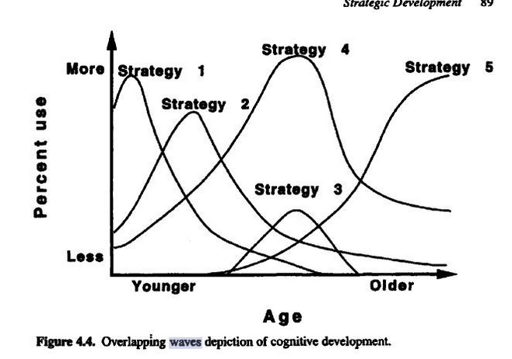
Overlapping Waves
Planes, Ages and Stages
Developmental Cascades
Waves and Cycles
Siegler (1996)
Notes:
Josh

Slide 20

Developmental Cascades
“A cascade, which can be used as a metaphor for thinking about development. Abilities begin at the top of the cascade and move down along different trajectories depending on which rocks and obstacles are encountered along the way. All drops of water, or developing abilities, end up in the pool below, but the particular position in the pool depends on the path traveled, which reflects the events and objects encountered along the way”.
Oakes & Rakison, 2020, p. 103
Notes:
Daniela

Slide 21

Developmental Cascades
“Children develop along any number of paths depending on factors such as how much freedom they are given to move, their relative size, the kind of caregiving they receive, and how language is spoken to them, and much more. It’s important to not consider differences as a way to identify deficits… understand how experience influences the shape of the cascade.”
Tamis-LeMonda & Lockman, 2023
Notes:
Josh

Slide 22

Key Tenants of Cascade Approach
All developmental change reflects the use of multiple mechanisms
The mechanisms of any specific developmental change operate at many levels involving sensation, perception, and cognition
The emergence of any behavior or milestone represents one point in an ongoing developmental cascade
Notes:
Daniela

Slide 23
Key Points of Developmental Cascades
Bidirectional Effect: Milestones influence development; development reinforce or reshape earlier skills.
Impact Across Domains: Cascades can occur within a single domain (ex: motor skills improve athleticism), or across different domains (social skills = better academic performance).
Cumulative Effect: Small successes or struggles early on can have a snowball affect over time, leading to advantages or disadvantages.
Not Predetermined: While cascades suggest a path of influence, it’s not a fixed destiny. Children are adaptable, and environmental factors, interventions, and individual differences can modify the course of development.
Notes:
Josh

Slide 24
* PROVOCATIONS – a Survey
* NAEYC (2020) DAP. 4th ed.
* THE TEACHER’S IMAGE OF THE CHILD
* DEVELOPMENTAL CASCADES
* PROVOCATIONS – a post Survey
OBJECTIVES
Notes:
Daniela

Slide 25
Encuesta
Inglés
Español
Notes:
Daniela

Slide 26

CO-LAB
Collaboration of 9 interdisciplinary research scholars, international, multi-disciplinary
Catalina Murcia, Casa de Paz Montessori, Dallas
Daniela Uribe Montserrat, Tecnológico de Monterrey
Danielle McLellan-Bujnak, Respectful Care® for Nannies & NCS
Josh Thompson, Texas A&M University-Commerce
Karen Walker, Texas A&M University-Commerce
Marta Mercado-Sierra, Texas A&M University-Commerce
Melissa Heinrich, The University of Texas at Dallas
Rachael Rose, Seattle, WA, USA
Zlata Stankovic-Ramirez, The University of Texas at Dallas
Notes:
Josh

Slide 27

THANK YOU!
Contact us:
http://faculty.tamuc.edu/jthompson/co-lab
Daniela A. Uribe Montserrat, MPA
daniela.um@gmail.com
Josh Thompson, PhD
josh.thompson@tamuc.edu
Notes:
Daniela

