Slide 1
DAP, Developmental Cascades, and Observation Tools
We will review developmentally appropriate practice (DAP) (three core considerations and nine principles) and how DAP has evolved over four iterations. We will introduce a new lens for viewing child development by discussing developmental cascades and exploring the ideas surrounding the image of the child from various practitioners working with or on behalf of young children. Multiple tools for observing children and their development will be shared with participants to illuminate the variety that exists among settings. Participants will also gain knowledge in strengths-based versus deficit-based approaches to children’s development and an understanding of what it truly means to “follow the child” in their development.

Slide 2
Meet the Presenters
Zlata Stanković-Ramirez
Karen Walker
Josh Thompson
Rachael Rose

Slide 3
Provocations – a Survey
As a part of our ongoing process to explore how to make meaning of this new paradigm, we are developing a survey designed to assess your experience. We appreciate your willingness to help us pilot test the survey and provide us some feedback on your understanding and perception of the survey items. Your individual responses in the pilot test phase will not be reported to anyone except those who are designing the survey.
Click here for SURVEY
Notes:
Daniela

Slide 4


Encuesta
Inglés
Español
Notes:
Daniela

Slide 5
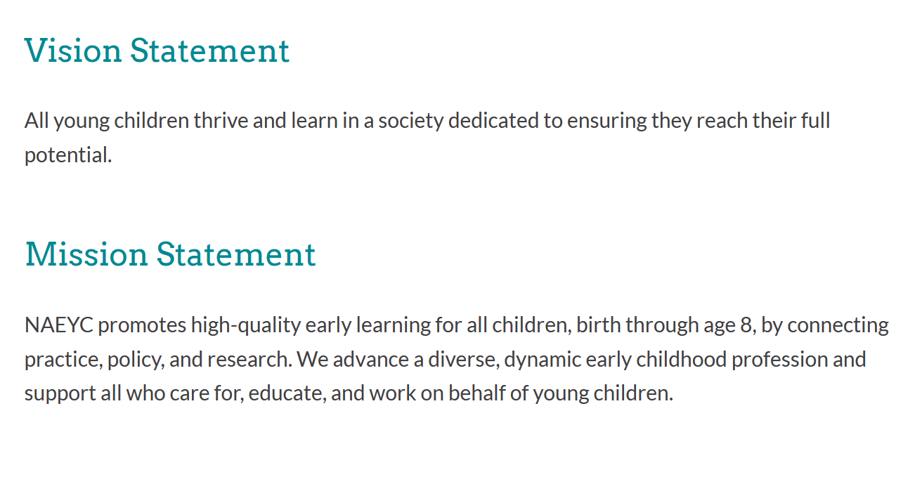
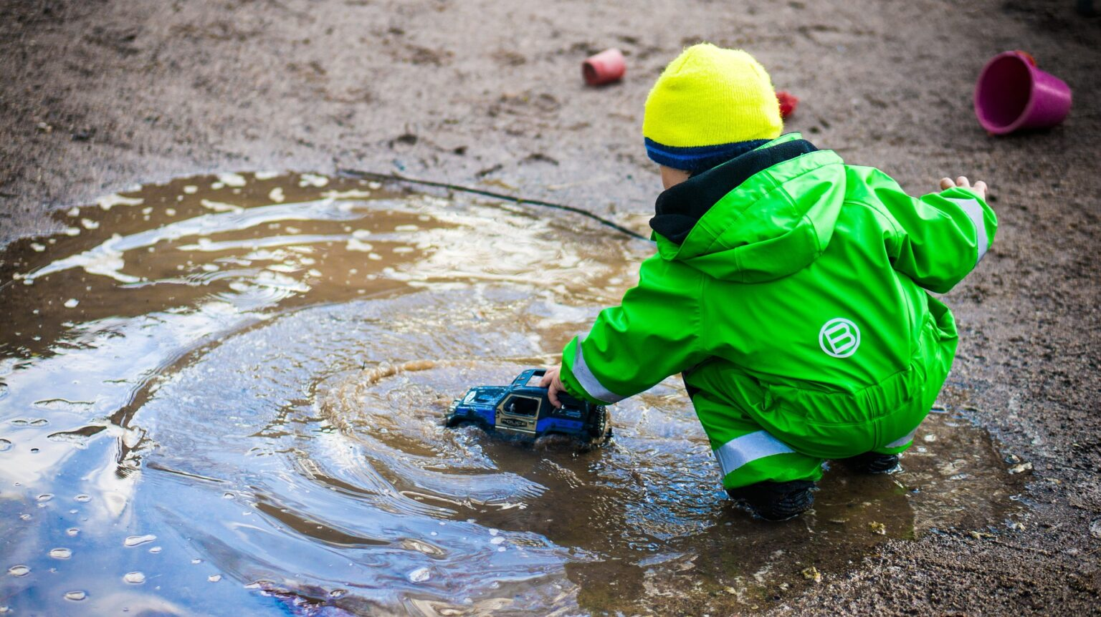
National Association for the Education of Young Children (NAEYC)

Slide 6
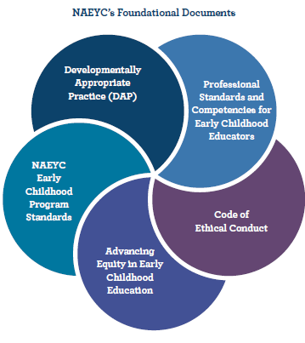
Developmentally Appropriate Practice (DAP) is the early childhood education framework that many early childhood education programs use as their pillars for creating quality care.

Slide 7

First 3 editions
* Position Statement
* Publication
1987: To prevent “push down” curriculum
2 core considerations
1997: Revised, three core considerations
Diversity: social and cultural context for
Child, Educator, Program
2009: “Best practice”
Typically developing children
Assessing normative instructional practices
Deemphasized cultural contexts
Leaned in toward “best practice” for all children

Slide 8
Turn and Talk
When did you first hear about DAP?
What does DAP look like in classrooms and learning environments?
Notes:
Josh – song “Clap”

Slide 9


* Shift in emphasis, away from standards-based and towards a transformative view of the young child
* Instead of Ages and Stages, Overlapping Waves
* Reemphasizing diversity, the unique individual
Developmentally Appropriate Practice in Early Childhood Programs – 4th Ed.
Position Statement 2020
Publication 2022

Slide 10

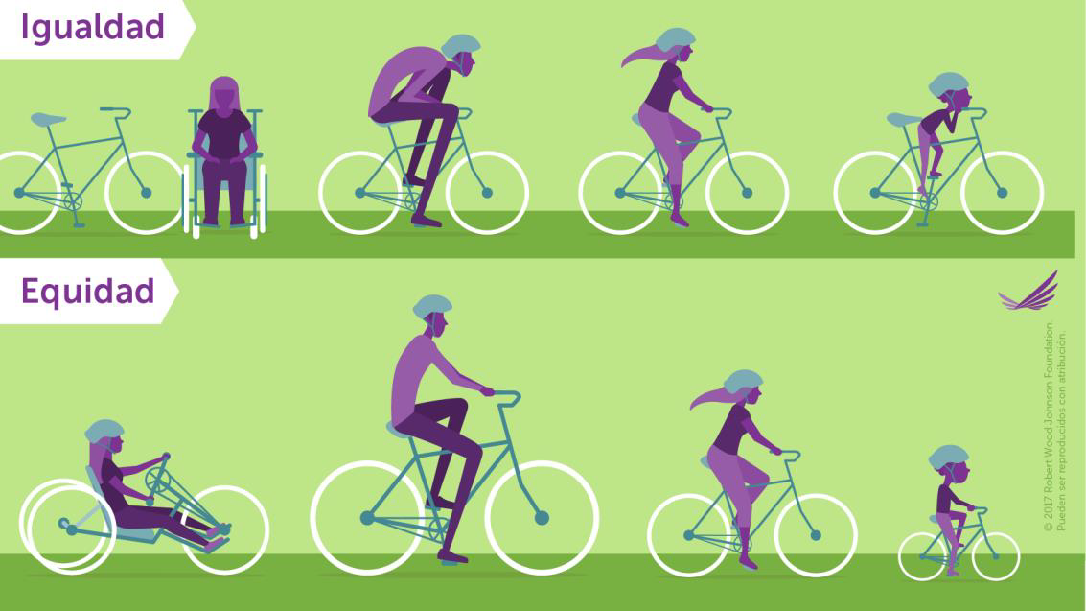

Slide 11
Our study of DAP
DAP
Stanković-Ramirez, Z. & Thompson, J. (2018). Rethinking developmental domains to improve classroom observations. Texas Child Care Quarterly, 42(2), 20-27.
Thompson, J., & Stanković-Ramirez. (2021). What early childhood educators know about developmentally appropriate practice. Phi Delta Kappan, 103(2), pp. 20-23.
Stanković-Ramirez, Z., & Thompson, J. (2022). A new view of Developmentally Appropriate Practice: What early childhood educators know about waves, individuals, and equity. TEPSA Leader: Texas Elementary Principals and Supervisors Association 35(2), 1-7.

Slide 12
Please take our Survey: "What EC Educators Know About DAP" https://tamuc.co1.qualtrics.com/jfe/form/SV_5mzvtbWOqXRtc1w
The purpose of this study is to discover what and ECCE professionals know about developmentally appropriate practice (DAP) in general, and specifically about recent changes in the 2020 revision. Your part in the study will be to respond to 5 short answer questions about the changes in DAP. It will take you about 30 minutes to review materials about DAP, and another 30 minutes answering the 5 short answer prompts.
http:faculty.tamuc.edu/jthompson/DAP

Slide 13

EVERY CHILD IS UNIQUE
“It’s a mistake to try to fit children into preexisting templates, insisting that every child achieve specific milestones at specific ages.”
Thompson & Stanković-Ramirez, 2021, p. 21

Slide 14

Waves and Cycles
“The waves of development, the ebb and flow of growth and processing, acquisition and reconsideration, all together map a process of typical child development, and attending to these waves empowers educators of children of all ages to go with the flow.”
Thompson & Stanković-Ramirez,
2022, p. 5

Slide 15

WAVES AND CYCLES
“The notion of ‘stages’ of development has limited utility; a more helpful concept may be to think of waves of development that allow for considerable overlap without rigid boundaries.” NAEYC 2020, 10
“The concept of stages does not accurately reflect the way development takes place … These waves consist of spurts of development interwoven with periods of little apparent growth.”
NAEYC 2022, 36
http://faculty.tamuc.edu/jthompson/co-lab

Slide 16

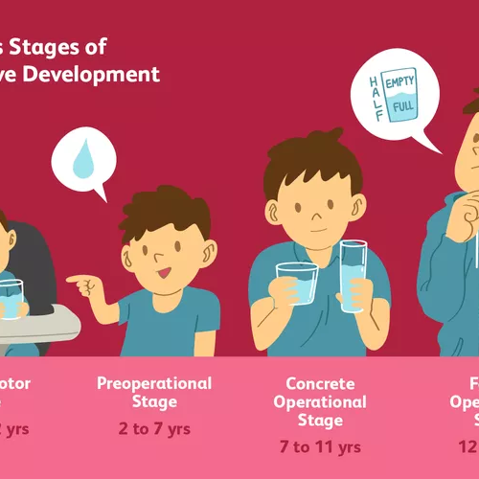
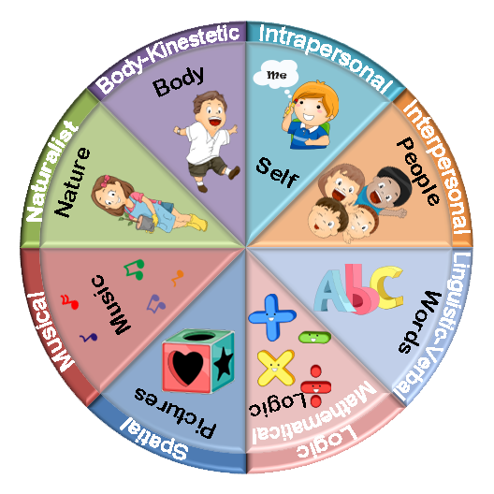
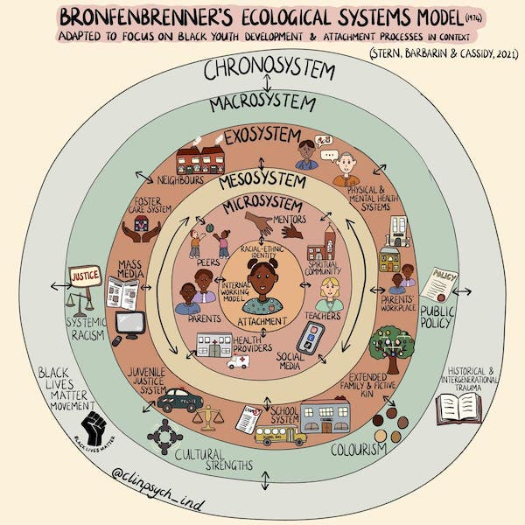

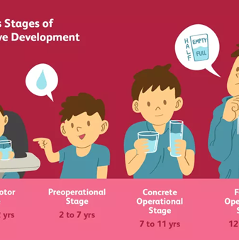
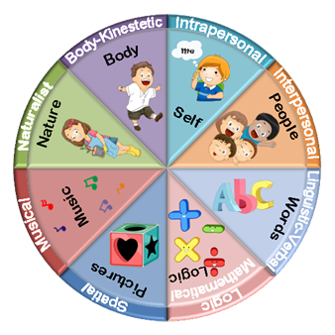

Theories of Development
Planes, Ages and Stages
Developmental Cascades
Waves and Cycles
Planes of Development
Ages and Stages
Multiple Intelligences
Ecological Systems
Montessori
Piaget, Vygotsky, Erikson
Gardner
Bronfenbrenner

Slide 17
Turn and Talk
Planes, Ages and Stages
Developmental Cascades
Waves and Cycles
How do Theories of Development affect teachers’ Image of the Child?
How does learning about Theories of Development help teachers change and grow?
Notes:
Daniela
Josh – song “I Like It Here in Arlington”

Slide 18
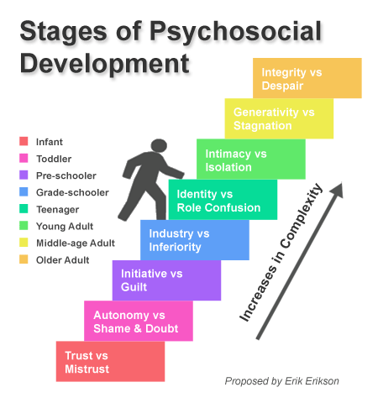
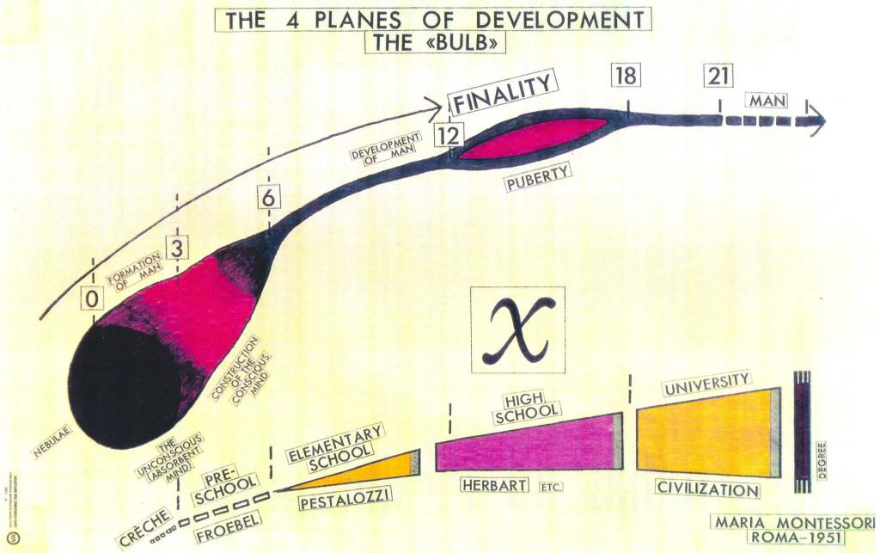
PARADIGM SHIFT

Slide 19

A simple liberating thought came to our aid, namely that things about children and for children are only learned from children.
“Follow the child”
Malaguzzi (1998, 51)

Slide 20
Developmental Cascades
Insights drawn from Developmental Psychology
Siegler (1996)
Masten & Cicchetti (2010)
Oakes & Rakison (2020)
Tamis-LeMonda & Lockman (2023)

Slide 21
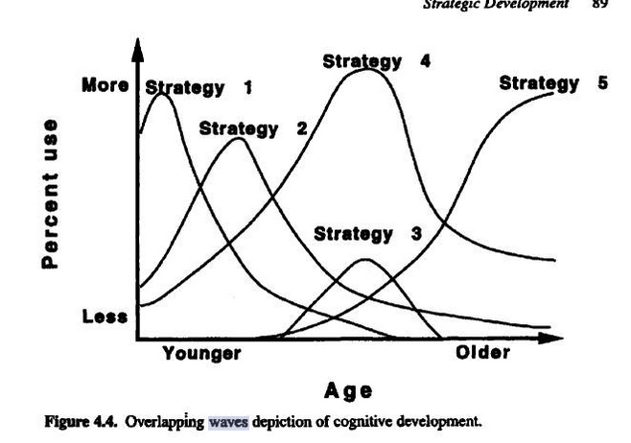
Overlapping Waves
Planes, Ages and Stages
Developmental Cascades
Waves and Cycles
Siegler (1996)
Notes:
Josh

Slide 22

Masten, A. S., & Cicchetti, D. (2010). Developmental cascades. Development and Psychopathology, 22(3), 491–495. doi:10.1017/S0954579410000222

Slide 23

Developmental Cascades
“A cascade, which can be used as a metaphor for thinking about development. Abilities begin at the top of the cascade and move down along different trajectories depending on which rocks and obstacles are encountered along the way. All drops of water, or developing abilities, end up in the pool below, but the particular position in the pool depends on the path traveled, which reflects the events and objects encountered along the way”.
Oakes & Rakison, 2020, p. 103
Notes:
Daniela

Slide 24

Developmental Cascades
“Children develop along any number of paths depending on factors such as how much freedom they are given to move, their relative size, the kind of caregiving they receive, and how language is spoken to them, and much more. It’s important to not consider differences as a way to identify deficits… understand how experience influences the shape of the cascade.”
Tamis-LeMonda & Lockman, 2023
Notes:
Josh

Slide 25

Developmental Cascades –
In child development, the concept of developmental cascades refers to the domino effect of early experiences on later development.
Bi-directional effects -
  Early milestones influence later development, and later development can reinforce or reshape earlier skills
Impact across domains -
  Development occurs within a single domain, or across multiple domains
Cumulative effects –
  Small successes or early struggles lead to larger advantages or disadvantages later
Not predetermined –
  Development is a path of influence, not fixed destiny

Slide 26

Constraints –
Shaping Factors
Biological Constraints
  Genetic makeup, brain development, physical capabilities
Environmental Constraints
  SES, family dynamics, access to resources
Experiential Constraints
  Life experiences

Slide 27

3 Vignettes
NAEYC (2022) Appendix A: DAP in Action: Educator Snapshots and Reflections. DAP in Early Childhood Programs Serving Children from Birth Through Age 8 (4th ed.), pp. 281–285.
A.5 Studying Birds in the Spring by Amy Blessing | A.7 “A Monster, I’m Not Afraid of Anything at All” by Ron Grady | A.8 The Name by Ron Grady

Slide 28
Observation Tools
http://faculty.tamuc.edu/jthompson/Observation

Slide 29
Meet Norm and Norma
Nope, this child doesn’t exist, not in your class, not in my family. Become aware of how your idealized, mental image of the child who ‘should be’ could potentially interfere with your ability to see the child who is there in front of you. Check your bias.

Slide 30
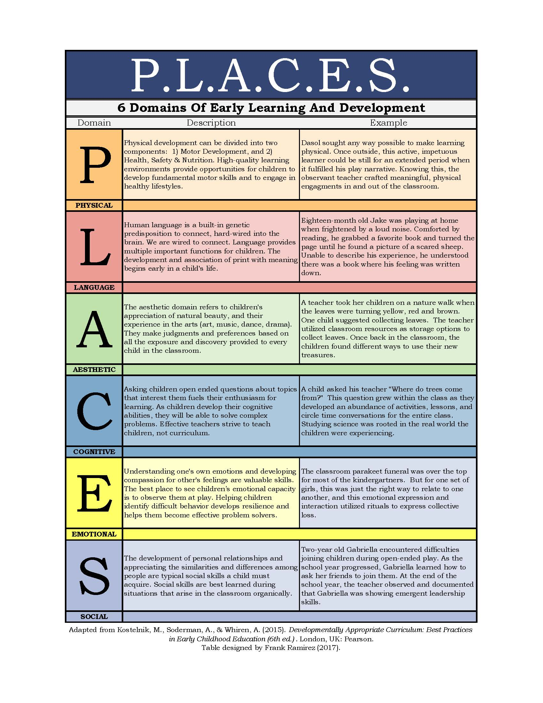

Slide 31


Infant
Toddler
PreSchooler
Kindergartner
Primary
School age
Pre-Teen
Adolescent

Slide 32
Kid Watching
Observing ongoing development through daily activities that are integral to instruction
Owocki & Goodman (2002)

Slide 33

Honoring the Moment
in Young Children’s Live:
Observation, Documentation,
and Reflection
by Ron Grady 2024
https://www.childology.co/

Slide 34
Ways of being with children as observer
Image of the children as full human beings
Meaningful mundane
Proximity

Slide 35
Ways of being with children through documentation
Documentation as Ethnography
Etic and Emic

Slide 36
Ways of being with children in reflection
Embracing the possibilities of proximate gaze
Advocacy as relationship
Interrogating Cultures

Slide 37
Turn and Talk
In what ways can Developmental Cascades transform a teacher’s observation protocols.

Slide 38
Types of Observations
Narratives
Sampling
Interviews
Home Visits
Child Study

Slide 39
Types of Narratives
Anecdote
Diary
Running Record

Slide 40
Narratives: Anecdotes
Anecdotes or incident/ accident reports take place in the moment, during learning, with everything else going on. Keep note paper handy. Include names and date/time stamp. May include photos or artifacts.

Slide 41
Narratives: Diary
Observational Diary method is written in reflection, “participant observations written down with exact precision, recorded systematically with method and rigor” (p. 23).

Slide 42
Narratives: Diary
“The diaries were in this sense ecological, open to the constant change of conditions and to capturing situations in their richness and complexity. A precious element is the recurrent attention to describing teachers’ subjective reactions to specific facts or lived experiences: The teacher feels like a part of the context. She is herself context and is an engaged and passionate participant of the context” Edwards & Rinaldi. 2009. The Diary of Laura. Redleaf. p. 13

Slide 43
Narratives: Running Record
Thick rich descriptions of everything going on within eyesight and ear range
  Write down everything – capture as much raw data as possible
  Don’t edit, just write
  Use time stamp
  Describe details
  Use verbs

Slide 44
Narratives: Running Record
Frame of reference, background info
Day/Date/Time
Describe the setting – draw maps
Demographics of people present
  Races, ages, genders (as relevant), languages, SES

Slide 45
Sampling
  Checklists
  Event Sampling
  Time Sampling
  Artifacts
  Portfolios

Slide 46
Portfolios
What goes in?
Who chooses?
How is material managed?
What does it mean?

Slide 47
Interviews and Conversations
While informal conversations are at the heart of true relationships, your professional service as an observer/ teacher brings intentionality into interviews and conversations.
  Protocols and scripts
  Transcripts
  Interview many contacts: child, friends/ classmates, other teachers, siblings, family, extended family – be sure to include father/ male figures.

Slide 48
Home Visits
Rich source of data, but primary purpose is to build connections and relationship
  Child’s home
  Teacher’s home
  Neutral ground (library, grandparents, friends house)

Slide 49
Child Study
Thick, rich descriptive observations of children in natural settings that captures all aspects of their lives: classroom environment, friendships, parents and family life, and community

Slide 50
Child Study
May include tools:
  Observation records (rr, diaries, samples)
  Portfolios
  Interviews
  Developmental checklists

Slide 51
Rules of engagement
Participant
Teacher
(Interventionist)
Observer

Slide 52
Analysis
What to do with what you observe?
  Making Inferences
  Drawing Conclusions

Slide 53
DAP, Developmental Cascades, and Observation Tools

Slide 54
Developmental Cascades –
In child development, the concept of developmental cascades refers to the domino effect of early experiences on later development.
Bi-directional effects -
  Early milestones influence later development, and later development can reinforce or reshape earlier skills
Impact across domains -
  Development occurs within a single domain, or across multiple domains
Cumulative effects –
  Small successes or early struggles lead to larger advantages or disadvantages later
Not predetermined –
  Development is a path of influence, not fixed destiny

Slide 55
Constraints –
Shaping Factors
Biological Constraints
  Genetic makeup, brain development, physical capabilities
Environmental Constraints
  SES, family dynamics, access to resources
Experiential Constraints
  Life experiences

Slide 56
Encuesta
Inglés
Español
Notes:
Daniela

Slide 57
Catalina Murcia, Casa de Paz Montessori, Dallas
Daniela Uribe Montserrat, Tecnológico de Monterrey
Danielle Bujnak-McLellan, Respectful Care® for Nannies & NCS
Josh Thompson, Texas A&M University-Commerce
Karen Walker, Texas A&M University-Commerce
Marta Mercado-Sierra, Texas A&M University-Commerce
Melissa Heinrich, The University of Texas at Dallas
Rachael Rose, Frisco, Texas, USA
Zlata Stankovic-Ramirez, The University of Texas at Dallas
Co-Lab
CO-LAB
Collaboration of 9 interdisciplinary research scholars, international, multi-disciplinary

Slide 58
DAP, Developmental Cascades, and Observation Tools
Zlata Stanković-Ramirez
Karen Walker
Josh Thompson
Rachael Rose
http://faculty.tamuc.edu/jthompson/Co-Lab

